Slide 1
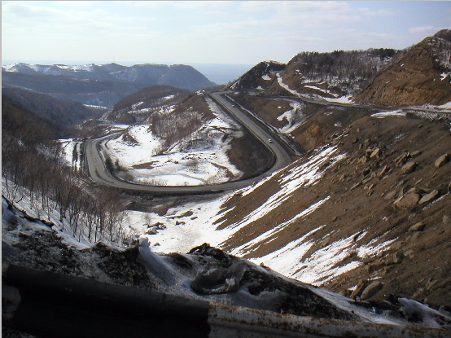

Governance and Development
Executive Course in
Communication and Governance Reform
July 18, 2011
Washington, DC
Ed Campos
Practice Manager
Leadership and Governance

Slide 2
The Evolving Governance Agenda
STATE –LED
DEVELOPMENT
1960s-70s
MARKET ORIENTATION
1980s
INSTITUTIONS & GOVERNANCE
1990s
MDGs/
Millennium
Phase
2000s
RESULTS
AGENDA
2010…
Conceptual / Intellectual paradigm shifts
mid-1970s
from Public Administration to Public Management
1990s
from Public Management to the New Public Management
early 2000s
from the New Public Management to Governance
Present . . .
From Governance to the Demand for Good Governance
Notes:
2

Slide 3
The World Bank has come a long way . . .
State in a Changing World (97)
O.P. Mainstreaming AC in CAS (99)
PSG Implementation Update (02)
Governance Pillar - CDF (98)
Strategic Compact (97)
Governance Strategy (00)
JDW “Cancer of Corruption” Speech (10/96)
Diagnostic/Data/ Monitoring Tools
Public Financial Management and Procurement
Administrative & Civil Service Reform
Civil Society Voice, Transparency, & CDD
State Capture
Legal & Judicial Reform
TI CPI (5/95)
Anti-corruption Strategy (97)
Gov/A-C Diagnostics start (98)
GAC
The ‘Prohibition’ Era
Broadening & Mainstreaming
Internal AC unit created in WB (98)
1st set of firms Debarred from WB (99)
Board endorses Integrity Strategy (04)
Formalization of INT (01)
PW Bank President (05)
1990
1995
1996
1997
1998
1999
2000
2001
2002
2003
2004
2005
2006
2007…

Slide 4
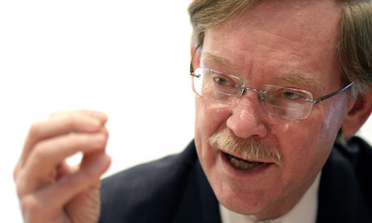
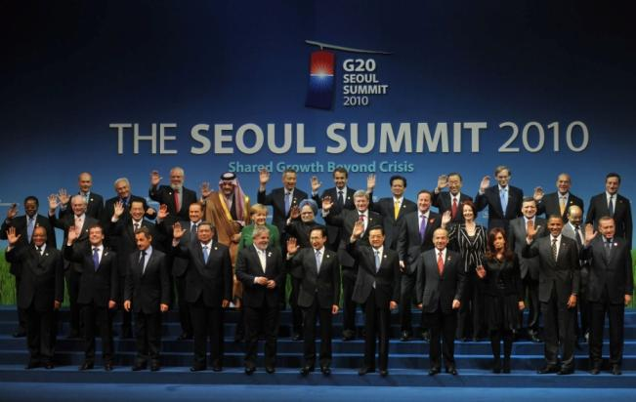
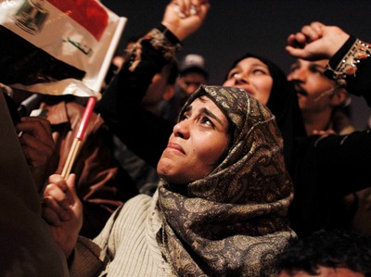
“We need to do development differently.”
Robert B Zoellick, President, The World Bank Group
New Direction: Democratizing Development
“There is a new opportunity, and certainly a pressing need, for dynamism in development economics. Software has brought new tools; the Internet has brought new communications; rising economies have brought new experiences…We need to listen and democratize development economics.”
Georgetown University o
New Direction: A New Social Contract
They want voice, and accountability ….They want information and the right to know, and to participate….They want a new social contract”
Peterson Institute
Notes:
One key driver of change which can result in a different approach is the rise of MICs.
The rise of MICs and the emergence of MICs in G20 not only signals a shift in global power, but the success of these countries in creating growth and battling poverty. These countries now represent important sources of South-South knowledge and investment, to complement what the North can do, that were not prominent a decade ago.
Technology, and particularly the phenomenal penetration of mobile phones into the developing world has opened dramatic new ways of participating in the political and economic decision making. Citizens are now able to track and give feedback on whether teachers are showing up in school, whether text books are being delivered. Combined with the Middle East Revolution, this calls for moving beyond governments to a broader social compact on development with government, civil society, citizens and non-state actors.
Finally the financial crisis has created fiscal and political pressures on traditional donor assistance, including the pressure and imperative to show concrete and tangible results. And later this year when the aid community convenes in Busan, it provides an opportunity to think of a new approach to support country-led development.

Slide 5
Governance and Development:
Lessons of Global Experience
An effective state is crucial for growth and poverty reduction (WDR ’97)
For an effective state, good governance is a cross-cutting priority for:
  Building a sound investment climate for growth (macroeconomic stability, rule of law, regulatory system, physical & financial infrastructure)
  Empowering people to make growth inclusive through effective delivery of basic services (education, health, social protection)

Slide 6
Good Governance matters for investment and growth
% Investment share in GDP
Income per capita Growth Rate
20%
2%
1.5%
1%
0.5%
15%
0%
-0.5%
-1.0%
10%
-1.5%
High
Medium
Low
High
Medium
Low
Governance Quality
Governance Quality measured by perception of 4000 firms in 67 countries on: (i) protection of property rights; (ii) judicial reliability; (iii) predictability of rules; (iv) control of corruption. World Development Report Survey 1997

Slide 7
Good governance is pro-poor
Governance & Growth
Reduction in the percentage of population living on less than $2/day due to the increase in the quality of governance (ICRG composite index)
Additional annual income growth due to an increase in the quality of governance (ICRG composite index) by 1 point
Source: Knack, 2002
Notes:
Causation? This “pro-poor-growth” result also holds for regressions using quality-of-institutions data from Business Environmental Risk Intelligence (BERI) from the early 1970s – measured prior to the 1970-92 growth period in question. Results from ICRG are highlighted here, and not results from BERI, because ICRG covers many more countries than does BERI. However we cannot fully rule out the possibility that part of the relationship here reflects feedback from growth to institutional quality – e.g. rapid growth in incomes of the poor may reduce the risk of political instability.
Knack, Stephen Social Capital, Growth, and Poverty: A Survey of Cross-Country Evidence, in The Role of Social Capital in Development: An Empirical Assessment, edited by Christiaan Grootaert and Thierry van Bastelaer, Cambridge, UK: Cambridge University Press, 2002.
The International Country Risk Guide (ICRG) has been published monthly since 1982. Overall, ratings are based on 13 indicators of political risk and 5 measures of financial risk. Most researchers have followed Knack and Keefer (1995) in using an additive index based on five of these variables: law and order tradition, quality of the bureaucracy, corruption in government, risk of expropriation of private investment, and risk of repudiation of contracts by government. The highest value of the additive index is 50, the lowest 5).
The dependent variable is the percentage of a country’s population living on lessthan $2/day. For countries with two or more observations on poverty, the most recent was used.
The regression controls for:
ICRG composite index;
time trend variable (because poverty is measured in different years for different countries – “year” is equal to the year in which poverty is measured minus 1985; it thus varies from 1, if poverty was measured in 1986, to 10, if poverty was measured in 1995; coefficients for this variable are negative and insignificant);
education - the percentage of adults who have completed primary, secondary, and tertiary schooling (only secondary education is significant); an increase of 5–6 percentage points in secondary schooling is associated with a fall in poverty of 1 percentage point.
These results support the view that social capital reduces poverty rates and improves—or at a minimum does not exacerbate—income inequality. Improving government and civil social capital are not the only ways, or necessarily the best ways, of reducing poverty. But there clearly is no equity-based justification in the data for opposing the strengthening of property and contract rights in developing countries.

Slide 8
Governance and Corruption
Not the same thing!
Governance
The manner in which the State
acquires and exercises its
authority to provide public
goods and services
Corruption
Using public office for
private gain
Corruption is an outcome – a consequence of weak or bad governance
Poor delivery of services and weak investment climate are other outcomes of bad governance

Slide 9
Poor Governance
Lack of
Transparency
Weak Voice &
Accountability
Monopoly Power
Wide Discretion
Inefficiency
Corruption

Slide 10
Administrative Corruption:
Private payments and other benefits to public officials in connection with the implementation of government policy and regulations
Nepotism & Patronage:
Favoritism shown to narrowly targeted interests by those in power such as granting favors, giving contracts or making appointments to office in return for political support
Corruption
State Capture:
Influence of powerful economic interests in the public and private sectors in the formation of laws, regulations, policies through illegal provision of private benefits for public officials

Slide 11
Governance has many dimensions
Citizens/Firms
Political Accountability
Political competition, broad-based political parties
Transparency & regulation of party financing
Disclosure of Parliamentary votes
Declaration/publication of assets, liabilities, income
Formal Oversight Institutions
Independent, effective judiciary
Legislative oversight (PACs, PECs)
Independent oversight institutions (SAI)
Global initiatives: UN, OECD Convention, anti-money laundering
Effective Public Sector Management
Public financial management
Civil service meritocracy & adequate pay
Service delivery and regulatory agencies in sectors
Decentralization/local public management
Ethics & leadership
Civil Society & Media
Freedom of press, FOI
Civil society watchdogs
Report cards, client survey
Beneficiary participation in projects
Citizens/Firms
Citizens/Firms
Private Sector Interface
Streamlined regulation
Public-private dialogue
Extractive Industry Transparency
Corporate governance
Collective business associations
Outcomes: Services, Regulations
Citizens/Firms
Notes:
Decentralization/local government can be an entry point
Upward influence of local governance – Philippines
Pressures from below can induce reforms at the top -- China

Slide 12
Governance has many dimensions
Citizens/Firms
Political Accountability
Political competition, broad-based political parties
Transparency & regulation of party financing
Disclosure of Parliamentary votes
Declaration/publication of assets, liabilities, income
Formal Oversight Institutions
Independent, effective judiciary
Legislative oversight (PACs, PECs)
Independent oversight institutions (SAI)
Global initiatives: UN, OECD Convention, anti-money laundering
Effective Public Sector Management
Public financial management
Civil service meritocracy & adequate pay
Service delivery and regulatory agencies in sectors
Decentralization/local public management
Ethics & leadership
Civil Society & Media
Freedom of press, FOI
Civil society watchdogs
Report cards, client survey
Beneficiary participation in projects
Citizens/Firms
Citizens/Firms
Private Sector Interface
Streamlined regulation
Public-private dialogue
Extractive Industry Transparency
Corporate governance
Collective business associations
Outcomes: Services, Regulations
Citizens/Firms
Notes:
Decentralization/local government can be an entry point
Upward influence of local governance – Philippines
Pressures from below can induce reforms at the top -- China

Slide 13
When Governance Breaks Down . . .
Citizens/Firms
Political Accountability
Political competition, broad-based political parties
Transparency & regulation of party financing
Disclosure of Parliamentary votes
Declaration/publication of assets, liabilities, income
State Capture
Formal Oversight Institutions
Independent, effective judiciary
Legislative oversight (PACs, PECs)
Independent oversight institutions (SAI)
Global initiatives: UN, OECD Convention, anti-money laundering
Effective Public Sector Management
Public finance management & procurement
Civil service meritocracy & adequate pay
Service delivery and regulatory agencies in sectors
Decentralization/local public management
Ethics & leadership
Civil Society & Media
Freedom of press, FOI
Civil society watchdogs
Report cards, client survey
Beneficiary participation in projects
Patronage & Nepotism
Citizens/Firms
Citizens/Firms
Private Sector Interface
Streamlined regulation
Public-private dialogue
Extractive Industry Transparency
Corporate governance
Collective business associations
Administrative Corruption
Outcomes: Services, Regulations
Citizens/Firms
Notes:
Decentralization/local government can be an entry point
Upward influence of local governance – Philippines
Pressures from below can induce reforms at the top -- China

Slide 14
Diagnostics: Drilling Down the Governance Landscape
Diagnosing Governance as a whole (Country Level)
Assessing the incidence of particular forms of corruption (within country): which areas are most affected?
Evaluating corruption at the sector level, e.g. education
Evaluating corruption in across sectors, e.g. procurement

Slide 15
Governance: Country Level

Slide 16
“Measuring” Quality of Governance and Corruption at the Country Level
(Kaufmann-Kraay indices:)
Rule of law
Political stability
Voice and accountability
Government effectiveness
Regulatory quality
Control of corruption
http://info.worldbank.org/governance/wgi/index.asp

Slide 17
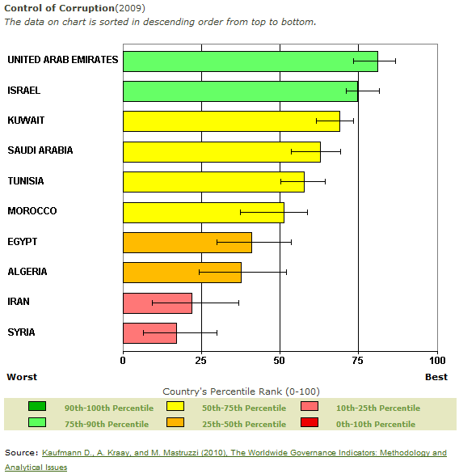
Control of Corruption: Cross country Comparisons

Slide 18
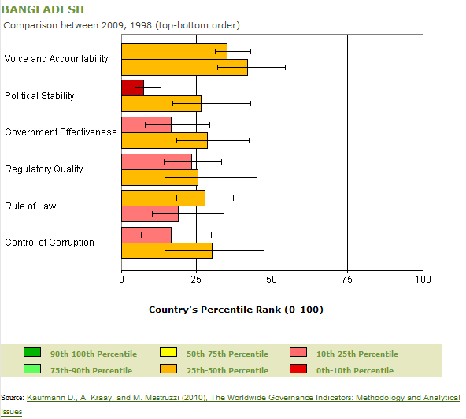
Governance Indicators: Bangladesh

Slide 19
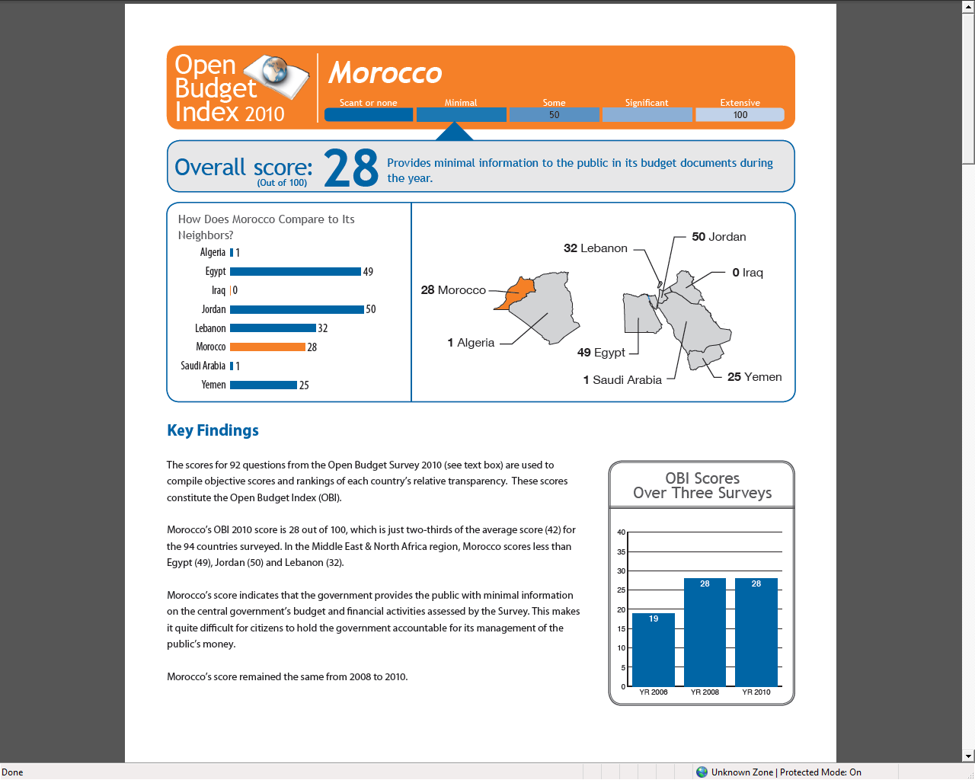

Slide 20
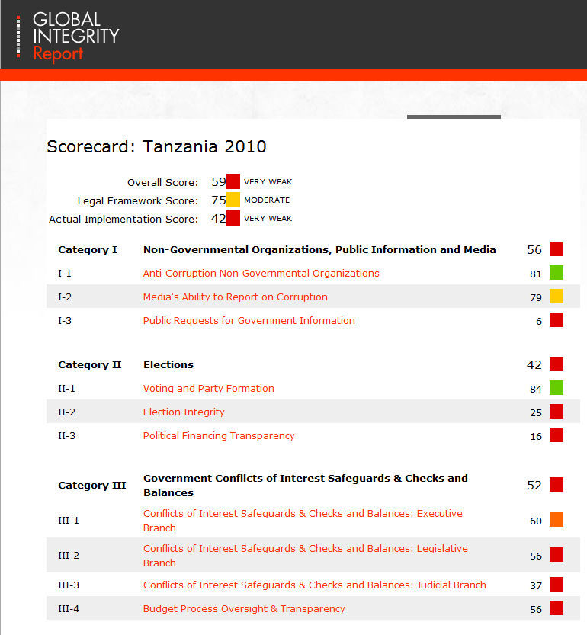
http://www.globalintegrity.org/

Slide 21
Governance: Across Categories of Corruption
State capture
Administrative Corruption
Nepotism & Patronage

Slide 22
Forms of Corruption: Assessing State Capture
Proportion of firms affected by capture of …
30
Parliamentary Votes
Presidential Admin. Decrees
25
Civil Court Decrees
20
15
10
5
Hungary
Estonia
Russia
Ukraine

Slide 23
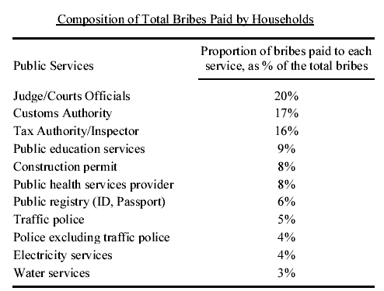
Service Delivery: Composition of Total Bribes Paid by Households in Cambodia
Forms of Corruption: Administrative Corruption

Slide 24
Forms of Corruption: Administrative Corruption
The “Bribe Fee” List: Unofficial Payments by Firms in Ukraine
Enterprises
Type of License/Service/”Favor” Average fee required admitting need to pay (1996) “unofficially”
Enterprise registration $176 66%
Each visit by fire/health inspector $42 81%
Tax inspector (each regular visit) $87 51%
Telephone line installation $894 78%
Lease in state space (square ft. per month) $7 66%
Export license/registration $123 61%
Import license/registration $278 71%
Border crossing (lump sum) $211 100%
Border crossing (percent of value) 3% 57%
Domestic currency loan from bank on 4% 81%
preferential terms (percent of value)
Hard currency loan on preferential 4% 85%
terms (percent of value)

Slide 25
Forms of Corruption: Patronage & the Market for Public Office
Public Officials Surveys: Purchasing Public Positions
Customs inspectors
60
48
41
Tax inspectors
41
52
25
Natural resource licensers
43
33
27
39
Judges
32
16
Albania
Ordinary police
25
40
Georgia
23
32
Latvia
Investigators/ prosecutors
33
14
Local officials
24
21
18
Based on 1998 World Bank surveys of public officials in these countries: 218 public officials in Latvia (with Latvia Facts); 350 public officials in Georgia (with GORBI); and 97 public officials in Albania (with ACER).
Ministers
5
10
19
0
20
40
60
80
Percent of public officials believed to have purchased their positions
Notes:
More recent surveys in Albania, Georgia, and Latvia were able to estimate the extent of bribes paid to “purchase” public jobs in these setting. The results of these surveys (and related surveys of citizens and firms) were discussed in workshops and reported by the press, and they helped to underscore the extent of the corruption problem, catalyze public discussion of the issues, and mobilize support for change.

Slide 26
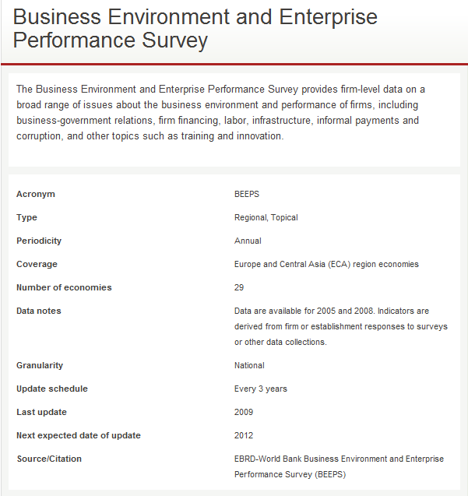
Business Environment and Enterprise Performance Survey
http://data.worldbank.org/data-catalog/BEEPS

Slide 27
Governance: Across Categories of Corruption
Within Country – Across Sectors

Slide 28
Stages of the Procurement Process
Public Procurement: Process Flow &
Corruption Risk Mapping
Procurement Planning
Preparation
Advertisement
Pre-qualification
Bid Evaluation
Award of Contract
Contract Implementation

Slide 29
PEFA’s Performance Measurement Framework
Budget Realism:
Is the budget realistic, and implemented as intended in a predictable manner?
Accountability and Transparency:
Are effective external financial accountability and transparency arrangements in place?
Comprehensive, Policy-based, budget:
Does the budget capture all relevant fiscal transactions, and is the process, giving regard to government policy?
Six PFM System Aspects
Control:
Is effective control and stewardship exercised in the use of public funds?
Comprehensive Fiscal oversight:
Are the aggregate fiscal position and risks are monitored and managed?
Information:
Is adequate fiscal, revenue and expenditure information produced and disseminated to meet decision-making and management purposes?
http://web.worldbank.org/WBSITE/EXTERNAL/PEFA/0,,menuPK:7313471~pagePK:7313134~piPK:7313172~theSitePK:7327438,00.html

Slide 30
Governance: Across Categories of Corruption
Within Country – Within Sector

Slide 31
Sector Level: The Value Chain
& Corruption Risk Mapping
Health Sector -- Delivery of Essential Drugs

Slide 32
Health Sector: Delivery of Essential Drugs
Tackling decision points vulnerable to corruption
Manufacturing
Competition & Transparency
Registration
Tracking systems
Random inspections
Selection
User surveys
Procurement
Monitoring based on transparent & uniform standards
Media coverage of drug selection committee meetings
Distribution
Prescription & Disbursement

Slide 33
How can we improve governance and reduce corruption?

Slide 34
Improving Governance Systems:
Supply and Demand
Supply-side
Strengthen capacities and organizational arrangements – leadership, skills, human resource & financial management systems – embodied in state institutions to deliver public goods and services
Demand-side
Strengthen accountability arrangements that enable citizens and firms to hold state institutions and officials responsible for decisions and outcomes:
State institutions --elections, political parties, parliaments, judiciaries
Non-state institutions -- free press/media, civil society organizations

Slide 35
Enhancing Transparency

Slide 36

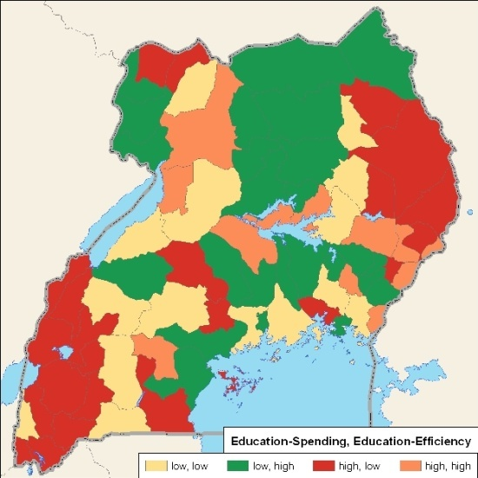
fosters dialogue on expenditure flows & efficiency
MORE OPEN
GOVERNMENTS
Links spending data to service delivery outcomes for all levels of government
20 countries and growing,
with Moldova live on website

Slide 37
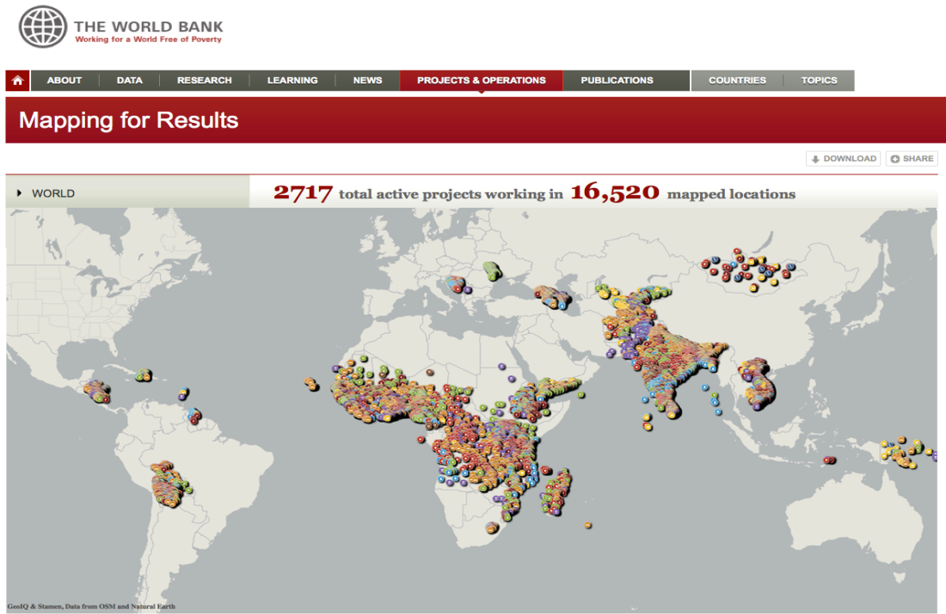
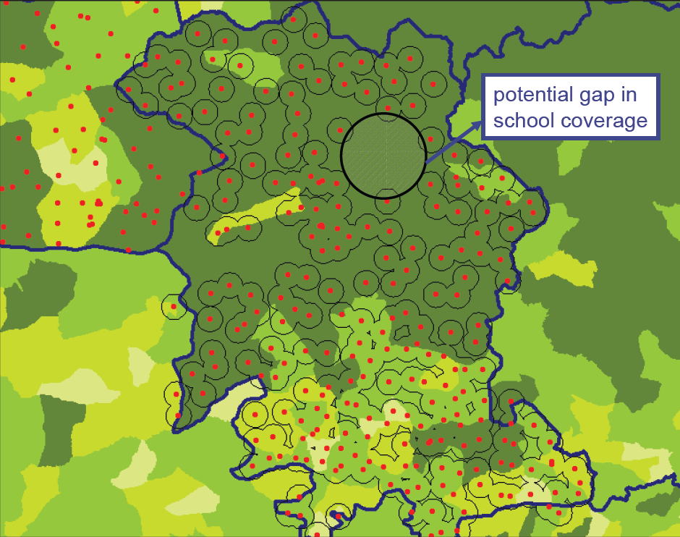
Mapping for Results increases transparency of resources
MORE OPEN
GOVERNMENTS
Strengthen transparency and oversight of aid by country stakeholders
Improve Project Planning and Targeting based on needs

Slide 38
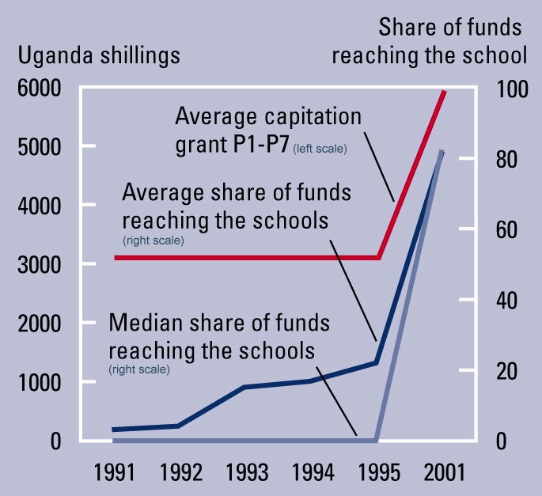
The Power of Transparency and Monitoring:
PETS & Primary Education in Uganda
Source: Reinikka and Svensson (2001), Reinikka and Svensson (2003a)
Notes:
First, strengthen poor people’s voice in policymaking by increasing their access to information.
In the early 1990s, primary schools in Uganda were receiving less than 13 percent of the money they were allocated for textbooks, equipment, and the like. Poor schools were receiving nothing.
To improve this dismal performance, the Ministries of Finance, Education and Local Government jointly launched a public information campaign on fiscal transfers. This created a groundswell of activity to increase the share going to primary schools. The newspapers published the funds flowing to schools on a monthly basis (they still do), and school principals had to post the entire school budget on the schoolroom door. The result was that the share increased from 13 percent to 80 percent.

Slide 39
Enhancing Accountability

Slide 40
The Accountability “Triangle”
Politicians/Policymakers
Political
accountability
Managerial/internal
accountability
Voters/Citizens
Social
accountability
Bureaucracy

Slide 41
What is Social Accountability?
. . . an approach towards building accountability
that relies on civic engagement,
where ordinary citizens and/or their organizations participate directly or indirectly in exacting accountability
It is ‘demand-driven’ or “bottom-up”
and complements non-effective, formal accountability systems

Slide 42
The Report Card: Improving Public Services in Bangalore
Source : PAC
Notes:
Dramatic improvements across nine city agencies between 1994 and 2003. Improvement even in city council, electricity, telephones across three report cards. Other services, hospitals, police, land, buses see huge improvements between 1999 and 2003. BATF tell similar story.

Slide 43
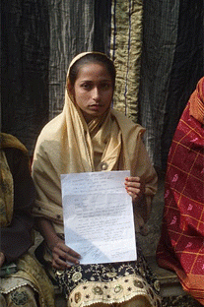
Access to Information creates an enabling environment for open government
MORE OPEN
GOVERNMENTS
Building the capacity of governments in Africa, South Asia, and Latin America to adopt & implement ATI and respond to citizens requests
Increasing public awareness and civil society capacity to use ATI for government accountability
Bangladesh
Shamima Aktar uses ATI to fight
for beneficiary rights for poor women
Notes:
Across the border in Bangladesh, Shamima Akter is an 18-year-old college student who lives in a small village in Jamalganj one of the nation’s poorest districts. The village has no running water or electricity and she and her friends walk five kilometers each way to college as there is no public transportation.
She is the secretary of a youth group that was recently trained in ATI by an NGO called Intercooperation supported by the World Bank Institute's (WBI). During the training they learnt about their right to information and that of their community members.
At the same time as the training, their local government administration was preparing a new Vulnerable Group Development list for 2011-12. Members on the list would receive financial assistance from the government. Shamima learnt that some extremely poor women from her village were not included in the list. She and her fellow group members decided to use their recent training lessons to fight this exclusion and submitted a ‘Right to Information’ application to see the list. Just a few years ago, Shamina would have been unable to submit such a request.
The application was filed with the local government chairman on January 10th. She did not receive any written information by January 25th, the official response date. By this time the Upazilla Nirbahi Officer, a local official, came to know about the complaint and reviewed the list with a small team which decided to remove a few names that were not eligible and to include four women who actually were.
On February 23rd, Shamima finally received the revised list from the authorities and saw the names of the four women. Shamima and other citizens can now verify if the beneficiaries selected are the appropriate ones and what criteria were applied.

Slide 44

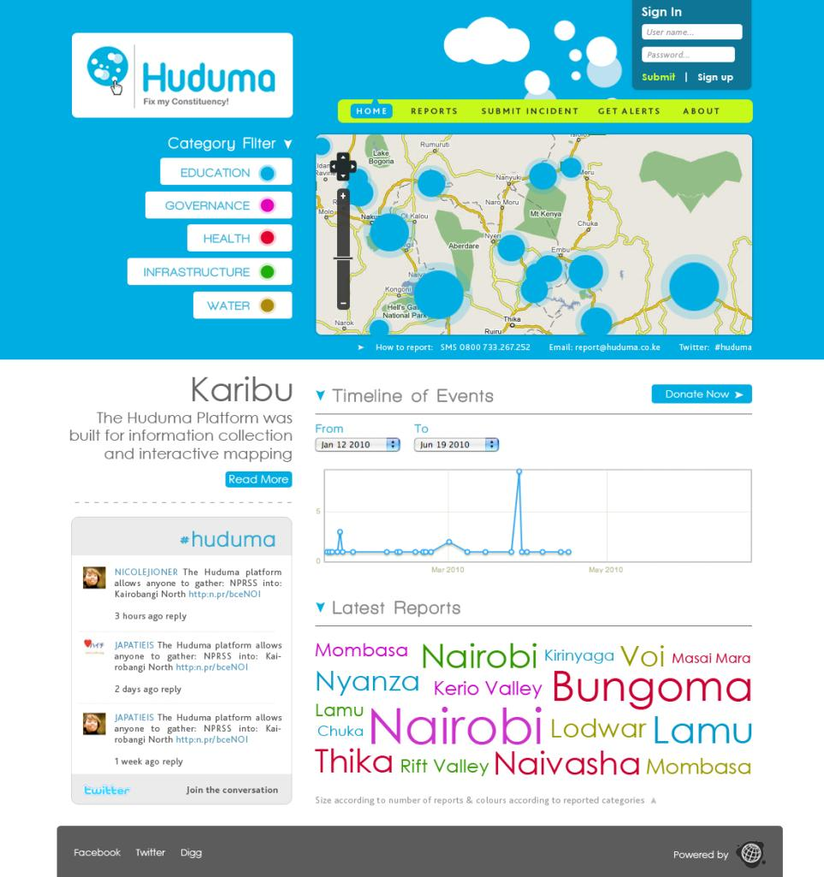
Geo-Reference with categories (Health, Water etc having different dots)
Timeline indicating response times
Bubble with location names getting bigger depending on veracity of problems reported
Flagging: of actions with delayed response (red) & (green) for efficiency.
Budget Layer: tagging project, concerns with budget information
Huduma, Kenya: Amplifying Citizen Voices Via ICTs
Notes:
Kenya working with with Ushahidi to build a tool designed to amplify citizen voices around how citizens experience public services.
Referencing the power and possibility of mass participation, this tool leverages the deep penetration of mobile phones, SMS short codes, and citizen desires to make their voices heard on public service problems.

Slide 45

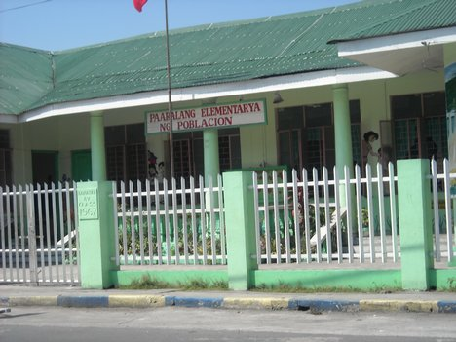
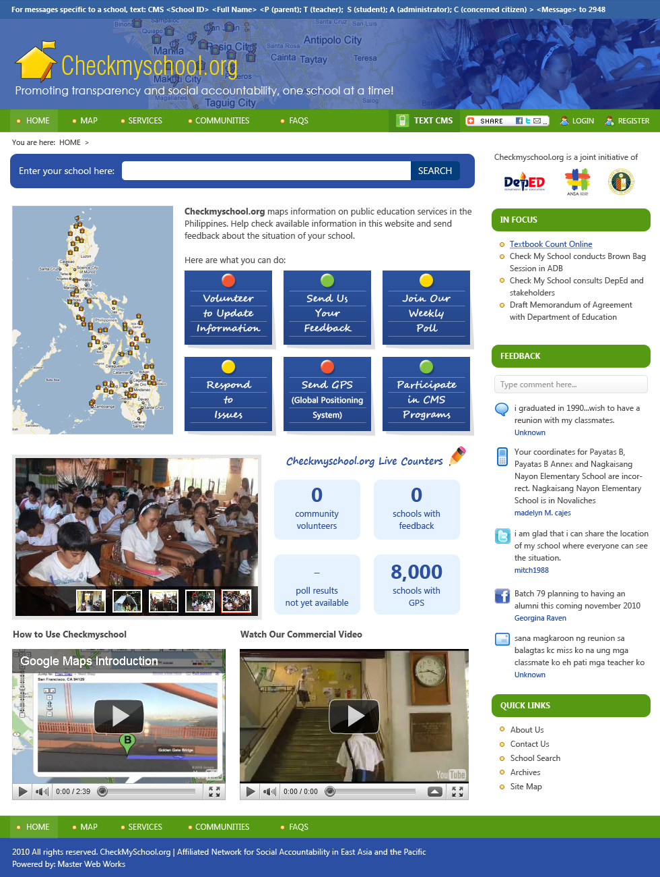
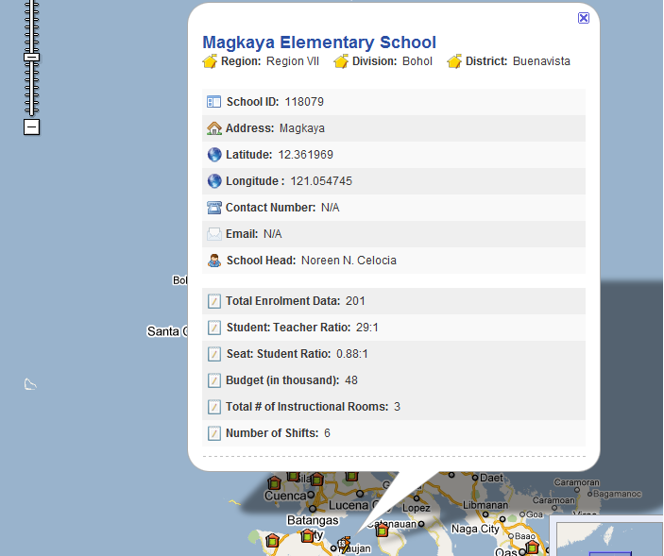
Elementary School in the Philippines
What is the schools budget?
Where are my teachers today?
  ANSA Network “Check My School” project

Slide 46

Strengthening Social Accountability by supporting networks of non-governmental stakeholders
MORE ENGAGED
CITIZENRY
AFR
SAR
LAC Legislative Transparency Network
ANSA
Arab World
EAP
CSOs, Media, Youth, Responsible Businesses, Parliamentarians
Global CSO Fund
ICT innovations that empower citizens to provide feedback (Co-Lab, Innovation Days)
ANSA Vision: Promoting Responsive
Government & Building Active Citizenship
Notes:
Strengthen and leverage ANSAs to build CSO capacities to improve accountability of core themes and sectors-PFM, procurement, GEI - through cross – country learning and collaboration, and incubating innovations
Support fledgling ANSA-MNA to be a catalyst for fostering accountability relationships for a new social contract between governments and citizens.
Proposed Global CSO Fund to support CSO capacity building for social accountability and service delivery
Improve capacities of multi-stakeholder coalitions (youth, journalists & ATI practitioners, business, parliamentarians) for reform advocacy
Pilot and scale up, through these networks, use of ICT for more open and accessible government

Slide 47
Increasing Competition &
Reducing Discretion

Slide 48
Public Procurement
Using ICT: Chile
Engaging CSOs: Philippines
All supplier companies register, indicating areas of business (e.g., IT, construction, furniture)
Public agencies submit tenders through internet
Automatic e-mail to all companies in selected area
Online information on name, position of official in-charge
Online information on results: who participated, proposals made, scores received, who won bid, historical record of agency’s purchases and contracts
Legal foundation a mess with over 100 laws and regulations
New omnibus law needed for clarity and predictability in the process
New law in 2003 with determined efforts of reform minded public officials allied with strong and unified advocacy efforts of CSOs to offset entrenched vested interests
For credible enforcement: requirement that all bids and awards committees must have at least one observer from a certified CSO
Extensive training of CSOs now under way

Slide 49




Contract Transparency and Monitoring
Observation of planning and awarding processes
Government
Monitoring of contract implementation
Monitoring Coalition
9 countries in Africa
Advocacy for reforms (e.g. Procurement Acts, Access to Information)
Private Sector
Civil society

Slide 50
The $64M Question ???

Slide 51
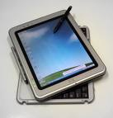
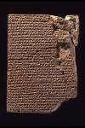
The Challenge of Reform
“HOW?”
Good Governance
Strategic Communications
Bad Governance
Coalition building
Notes:
Isn’t development work all about change? So all donors are basically attempting to do this. This is why the “How” slide is useful.
The Bank probably has the among the best diagnostic instruments and skills in the world and it has applied these very well:
to analyze problems and to develop and recommend technical solutions, i.e. basically to paint a very good picture of a bad and a better equilibrium
the basic presumption is that, with a little prodding through conditionality (and the carrot of funding), governments will seek ways to implement the needed changes.
The experience to date however has been quite dismal, particularly in the area of governance
We can cite the Bank experience with slow or non-disbursements and re-structuring of projects and, as a consequence, the emerging concern today and interest in addressing implementation issues in Bank projects.
The challenge is in the “How” (how can we move to a better state)
For WBI, catalyzing change is about dealing head on with the “How”: using its unique assets – global connector and innovative CB instruments – to help create the space needed to encourage and nurture reform efforts.”
We define Leadership as the process of intentionally mobilizing people, ideas, meaning and resources toward achieving a purpose

Slide 52
Thank You
Governance and Development
History
Framework
the “HOW”
Definitions
Diagnostics
Reform Solutions

Slide 53
Extra Slides

Slide 54
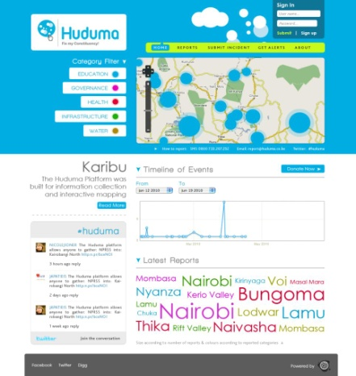
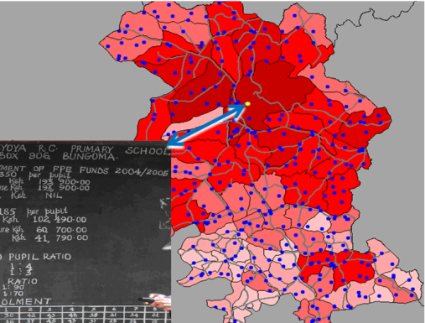
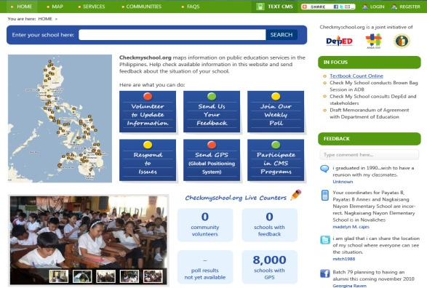
Open Budgets
Improved Access to Public Expenditure Data
Enabling Environment through Right to Information Legislation
Budget Data Visualizations
In East Africa in May 20, 2011
(Kenya, Uganda, Tanzania)
Mapping for Results
Bungoma County Schools, Kenya
Citizen Feedback though Use of ICTs

Slide 55
Corruption poses three risks
Development Effectiveness Risk
That corruption will undermine the impact of development efforts in general and in Bank-supported projects
Reputational Risk
Fiduciary Risk
That Bank lending in countries with corrupt leaders will tarnish the Bank’s reputation
That Bank resources will be misappropriated and in some cases loans may not be repaid

Slide 56
Desired Impact
X
Development Outcomes
X
Corruption

Slide 57
What might happen with over zealous ring fencing?
X
Development Outcomes
X*
Corruption

Slide 58
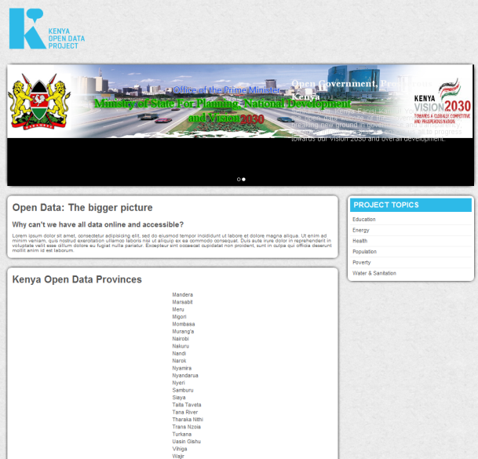
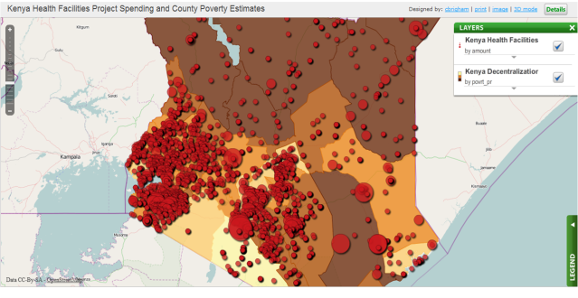
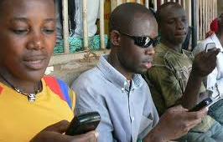
EXAMPLES (1)
Kenya: Open Data / Open Government Initiative
Improved Budget Transparency & Accountability
Open Access to Public Expenditure Data
at national/ local level
Open Data
Free, open and easy access to Census and Socio-Economic Indicator Data
Mapping Public Expenditure/Poverty
ICT for Social Accountability
Enabling Citizen Feedback on government programs

