Slide 1
The Social Network Revolution
Francois Bar
with thanks to Francis Pisani

Slide 2
1. massive growth, a new social web in one year (e.Consultancy):
Then: Twitter has 75m user accounts, but only around 15m are active users on a regular basis.
Now: Twitter now officially claims to have 175m registered users, although it's unclear what percentage regularly user the service.
Then: LinkedIn has over 50m members worldwide.
Now: Officially, Linkedin has grown 100%, now having over 100m professionals who use the platform worldwide.
Then: Facebook has 350 million active users on global basis.
Now: Facebook officially hit the half-billion member mark last year. According to figures from Socialbakers, there are now some 640m Facebook users worldwide.

Slide 3
Then: 50% of active users log into Facebook each day. This means at least 175m users every 24 hours.
Now: Still citing the 50% active rate, using the official 500m figure, this means at least 250m users every 24 hours. This is more than a 40% increase in 12 months.
Then: Flickr hosts more than 4bn images.
Now: Flickr continues to grow at a steady rate, having increased by some 25% in the last twelve months. At the end of 2010, it was hosting more than 5bn images.
Then: Wikipedia has 14m articles and 85,000 contributors.
Now: Wikipedia now has more 17m articles. The site now has an army of 91,000 active contributors.
Then: 65m users access Facebook through mobile devices.
Now: It may well be the year of mobile... For Facebook. Users accessing the site through mobile devices now tops 200m - an enormous 200% increase in around a twelve-month period.

Slide 4
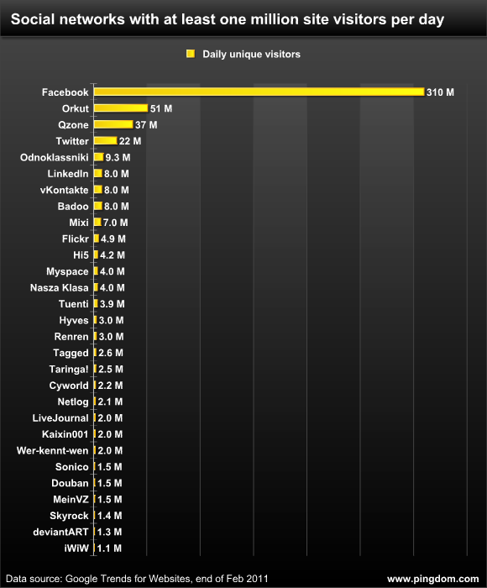
source: RoyalPingdom

Slide 5
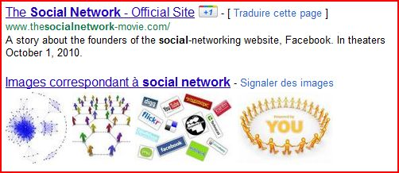
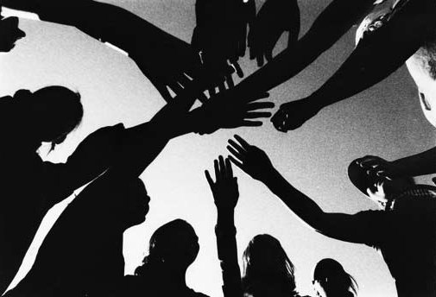
a new web: from content to connections
content / search => users/social networks:
not just what you know, but whom you know
Google's +1
From divergence to convergence

Slide 6
2. social networks and the arab spring
sparks and powder kegs
a. new communication ecosystem
"The combination of Google, Twitter, Facebook and Al Jazeera in the hands of a new generation of youth armed with cell phones broke social shackles" (Antoní Gutiérrez-Rubí)
Feb2011: 5 million Egyptians (out of 80m) have a facebook acct., 77% have a mobile, 21% internet penetration
b. spark: Mohamed Buazizi - broadcast by Al Jazeera, retransmitted by social nets
c. the spirit of revolution: microblogging has its own narrative capability to transmit emotions
+ collective awareness

Slide 7
3. limits and dangers
a. limited penetration - internet, mobiles, facebook not universal
BUT high penetration among urban youth + Al Jazeera audience
b. there have been revolutions without ICTs...
c. reliability? government shutdowns
d. networks effective against hierarchies (Tunisia, Egypt). less against tribes? (Libya, Yemen)
e. social networks can also be used against dissidents
facebook intel

Slide 8
4. power and social networks
overthrowing is different from governing and rebuilding...
what type of regime could emerge from struggles led by leader-less network organizations?
how can power be taken?
the "adrenalin paradox"

Slide 9
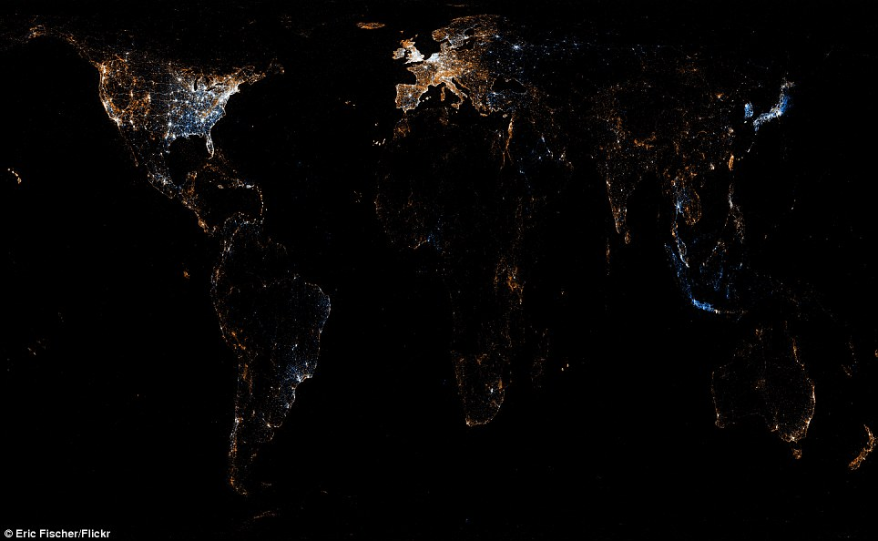
flickr and tweets

Slide 10
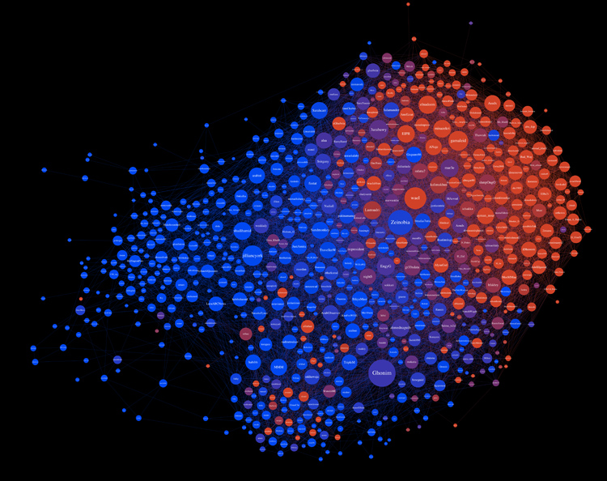
egypt tweets by googlerank,
in english and arabic
Kovas Boguta

Slide 11
synthesizing, measuring, etc.
Some examples:
  facebook analytics: insights,etc...
  twitter tools: grader, tweetstats, retweetrank, wildfire, etc...
  flickr and twitter maps: major cities
  crowd-mapping: Ushahidi's Libya crisis map
  twitter-mining: R-shief
  crowd-slicing: many eyes on egypt

