Slide 1
Linking Communication and Governance
Caby Verzosa and Sina Odugbemi
Executive Course in
Communication and Governance Reform
Washington, D.C., July 18, 2011

Slide 2
Overview
Adaptive vs. Technical Challenges
Table Work – Governance Challenges
Communication and Governance
Obstacles to Reform – 3 W’s
Mobilization Interventions
Public Opinion and the Public Sphere
Table Exercise: 3 W’s

Slide 3
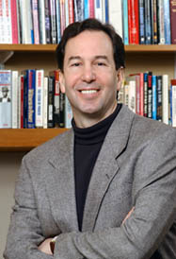
Adaptive vs. Technical Challenges
Technical problems:
can be defined clearly;
known solutions exist.
Adaptive challenges: hard to identify clearly; involve changing hearts and minds; imply having to choose between contradictory values.
Successful and sustainable reform requires addressing both.
Source: http://www.cambridge-leadership.com/adaptive/index.php4
Notes:
3

Slide 4
Adaptive Challenges and Communication
Adaptive challenges are amenable to communication based-solutions.
Technical experts usually find these challenges messy and difficult to deal with; prefer “reform by stealth”
Notes:
4

Slide 5
Table Work
Based on what’s been discussed today and from your own experience, what are the governance reform challenges in your own country?
Among these challenges, which are amenable to communication-based solutions?

Slide 6
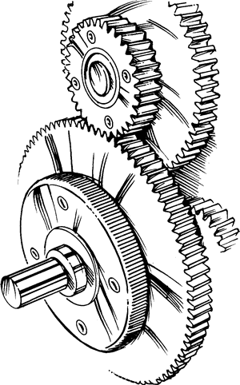
Communication and Governance
The challenge of policy change and governance reform
Technocratic preferences vs. realities of change processes
How do you get people to do what you want?
  Coercion
  Manipulation of incentives
  Persuasion
Decentered governance almost everywhere

Slide 7
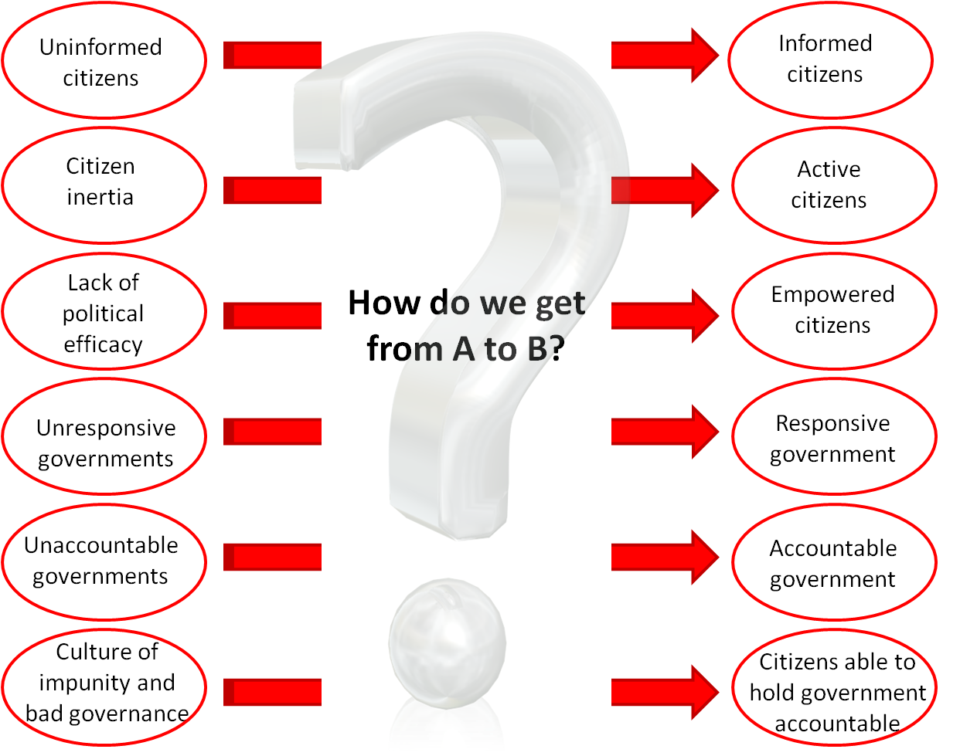
The Missing Middle

Slide 8
Obstacles to Reform I
Political Will
Support from enough political leaders that results in policy change
Necessary conditions:
  A sufficient set of political actors
  Common understanding of a particular problem on the public agenda
  Genuine intent to support
  Commonly perceived potentially effective policy solution

Slide 9
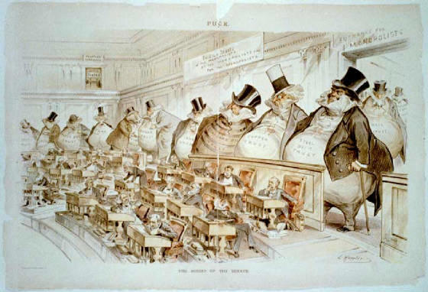
Obstacles to Reform I
Political Will: Facets of the Iron Law of Oligarchy
Persistence of power and elites: institutions may change, but powerful groups maintain command (e.g., US South, Latin America)
Persistence of bad rulers: new rulers promise change but turn out to be as bad as the old ones and adopt their most distortionary policies (e.g., sub-Saharan Africa after independence)
Persistence of bad rules: institutions change, but regenerate the same economic and political equilibrium (e.g., revolutions gone wrong)
Daron Acemoglu, 2011

Slide 10
Obstacles to Reform II
Organizational Will – The Middle Managers Problem
Middle managers are at the center of organizational structure positioned to exert influence and share knowledge upwards and downwards …
… and at the same time they are often stereotyped as “boring, bureaucratic and a layer of clay through which nothing passes.”
Resistance, apathy, pretended agreement... Sounds familiar? (Ever heard of the World Bank?)
Studies suggest - the problem is the lack of inclusion and empowerment

Slide 11
Obstacles to Reform III
Public Will: The Problem
Machiaveli: The Prince
“And it should be realized that taking the initiative in introducing a new form of government is very difficult and dangerous, and unlikely to succeed. The reason is that all those who profit from the old order will be opposed to the innovator, whereas all those who might benefit from the new order are, at best, tepid supporters of him. This lukewarmness arises partly … from the skeptical temper of men, who do not really believe in new things unless they have been seen to work well. The result is that whenever those who are opposed to change have the chance to attack the innovator, they do it with much vigour, whereas his supporters act only half-heartedly; so that the innovator and his supporters find themselves in great danger.”
Machiavelli, 1988, p. 20/21

Slide 12
Obstacles to Reform III
Public Will
Reforms may entail long-term benefits to many, but short-term benefits to a few, well-connected stakeholders
If costs are well known, but benefits are not, potential losers with access and representation in the political world can oppose and derail reform
Example: promotion of rice exports in East Asia
  Likely gains for small rice farmers
  More competition for large rice millers (politically more influential)
Public will = Public support that results in policy changes and reform

Slide 13
Obstacles to Reform III
Public Will
“The domination of an organized minority … over the unorganized majority is inevitable. The power of any minority is irresistible as against each single individual in the majority, who stands alone before the totality of the organized minority. At the same time, the minority is organized for the very reason that it is a minority.”
Gaetano Mosca, 1939, p. 53
Communication challenge:
How to mobilize the unorganized majority?

Slide 14
Communication Interventions for Mobilization
Information
Attitude
Change
Behavior Change
Sustainability
Mobilized Public
Attentive and active members, well informed with specific long-term issue interests, e.g., interest groups, advocacy organizations.
Active Public
Elites, regular formal and informal political participation, recruit supporters for their position in the realm of the attentive public.
Attentive Public
Individuals that are informed and interested in public affairs, audience for political actors.
Voting Public
Electorate, unorganized. Elections as the most visible manifestation of public opinion.
General Public
Entire population, unorganized, disconnected, individual opinions.
Communication is not a magic bullet, but it helps!

Slide 15
The Democratic Public Sphere
Issue-Based Information Flows
The Private Sphere:
The State (national, state, local):
Constitutive Elements:
Laws and civil liberties (especially freedom of speech, press, assembly, & conscience)
Free, plural, and independent media systems
Access to public information
Civil society
All sites for everyday talk
  about public affairs
Citizens
Executive
Households
Legislative
Public Debate
& Discussion
Issue-Based
Public Contestation
Firms
Judiciary
INFORMED PUBLIC OPINION (HOPEFULLY)
Notes:
15

Slide 16
The Democratic Public Sphere
On a structural level, a democratic public sphere is fundamental to achieving good governance outcomes
“…little political change happens without the dissemination and adoption of ideas and opinions in the public sphere. Access to information is far less important, politically, then access to conversation.”
Clay Shirky, 2011, p. 35
Seize every opportunity to improve the public sphere where you are

Slide 17



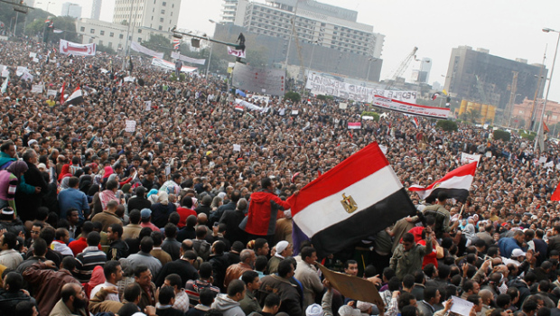

The Democratic Public Sphere
Satellite media
Everyday talk
New media
Legacy media

Slide 18
Table Exercise:
Communication-Based Solutions
Political, organizational, or public will?
What’s communication’s contribution?
Examples:
Orissa, India: Public Enterprise Reform
Bulgaria: Tax Administration Reform
Wenling City, China: Infrastructure Reform

Slide 19
Successful and sustainable reform requires addressing both technical and adaptive challenges.
Adaptive challenges are amenable to communication based-solutions.

Slide 20
Overview
Adaptive vs. Technical Challenges
Table Work – Governance Challenges
Communication and Governance
Obstacles to Reform – 3 W’s
Mobilization Interventions
Public Opinion and the Public Sphere
Table Exercise: 3 W’s

Slide 21
Linking Communication and Governance
Caby Verzosa and Sina Odugbemi
Executive Course in
Communication and Governance Reform
Washington, D.C., July 18, 2011

Slide 22
Orissa, India: Public Enterprise Reform
Orissa is one of India’s poorer states. It is located on the east coast just south of West Bengal and north of Andhra Pradesh. On the eve of the new millennium, the state government’s financial woes and the condition of its public enterprises were sources of great concern. The new chief minister, Naveen Patnaik, inherited a political machine that lacked discipline. Even among Orissa state legislators and many senior civil servants, there was neither an appreciation of the size and scope of the public enterprise problem nor the resolve to confront it. Yet the new chief minister, together with a small group of senior civil servants, championed needed reforms, took the debate to the people, and built a statewide consensus.
Orissa published white papers on state finances in 1999 and 2001, which admitted that government’s indiscriminate borrowing had not yielded expected results in terms of development, growth, and poverty alleviation. Instead, the state was in a debt trap and at a crisis point. The papers called for immediate and drastic steps to turn the fiscal situation around and proposed public debate on the issue. The need for enterprise reform, part of a much broader government drive toward solvency, began to resonate inside and outside government. One Indian economist commented: “The fact that Naveen Patnaik is among the few chief ministers to be returned to power after a state election is a testament to the fact that the people supported the tough approach taken by his government in its previous tenure”. That success was, first and foremost, the result of competent communication.
- Masty (2008), Governance Reform…

Slide 23
Bulgaria: Tax Reform
The Bulgarian government decided to unify and modernize its tax collection facilities by combining the revenue-collection function (NSSI) and the General Tax Directorate (GTD) into a new, single tax authority: the National Revenue Agency (NRA). The need for change was enormous. Bulgaria’s tax system deterred foreign investors and citizen-taxpayers alike.
Initially, technocratic and bureaucratic reluctance to internal and external communication was high. To address this challenge, the NRA devised an internal communication strategy. In a span of three months, the NRA held 25 half-day meetings, each with 100 to 300 participants from NSSI and GDT. All local agency employees were invited to the meetings. Senior NRA officials, together with participants from the two merging agencies, made presentations summarizing public opinion survey data on attitudes about taxes, discussed the need for enhanced revenue collection, and sketched out how the government planned to unite the two agencies. Time was also spent discussing opportunities for career advancement and benefits for the small number of employees who would lose their jobs in the merger. New procedures for answering employee questions via the newly created NRA Intranet were also announced. Follow-up letters were sent to all 8,000 employees of both agencies, recapping information disseminated during the meetings, highlighting issues raised by employees, and restating the intranet system through which queries would be answered. Internal transparency and dialogue have been credited for building support among the people on whom rigorous and unfamiliar demands would soon be placed.
- CommGAP (2008), Governance Reform…

Slide 24
Wenling City, China: Infrastructure Reform
In Zeguo township, Wenling City, about 300 km south of Shanghai, citizen deliberation was used to help select 10 infrastructure projects from a list of 30 possible options. For local officials, the deliberative method used -- Deliberative Polls, developed at Stanford University -- offered a transparent, balanced, and representative way to provide public input into the decision-making process. Like many other municipalities, they had previously held Kentan, or “heart to heart,” discussion meetings as a form of local consultation. But these open meetings were dominated by the intensely interested, the self-selected, and the local notables, and they lacked a decision process. The Deliberative Poll, which draws on a random sample of the population, added to perceptions of transparency and legitimacy. As local party leader Jiang Zhaugua observed, “I gave up some power and found that I had more.”
During the Deliberative Polls, all the possible infrastructure projects were represented by experts on panels, and the briefing materials, which provided the agenda for discussion, had arguments for and against each project. When the resulting preferred projects were classified in terms of their contribution to the entire city rather than just one village or another, there was a clear pattern of increasing support for projects of wider collective benefit. In addition, the results have actually been implemented; the public’s preference for sewage treatment plants rather than for more highways and for a people’s park for recreation rather than for a fancy town square have changed the city’s priorities of development.
- Fishkin et al. (2008), Govenance Reform…

