Slide 2

Mobile Voices
Open-source storytelling platform for recent immigrants in Los Angeles to create and publish stories about their community, directly from cellphones
cheap
intuitive
any phone
any network
private
our way
multi-lingual
multi-country

Slide 3
community partner and users

Slide 4
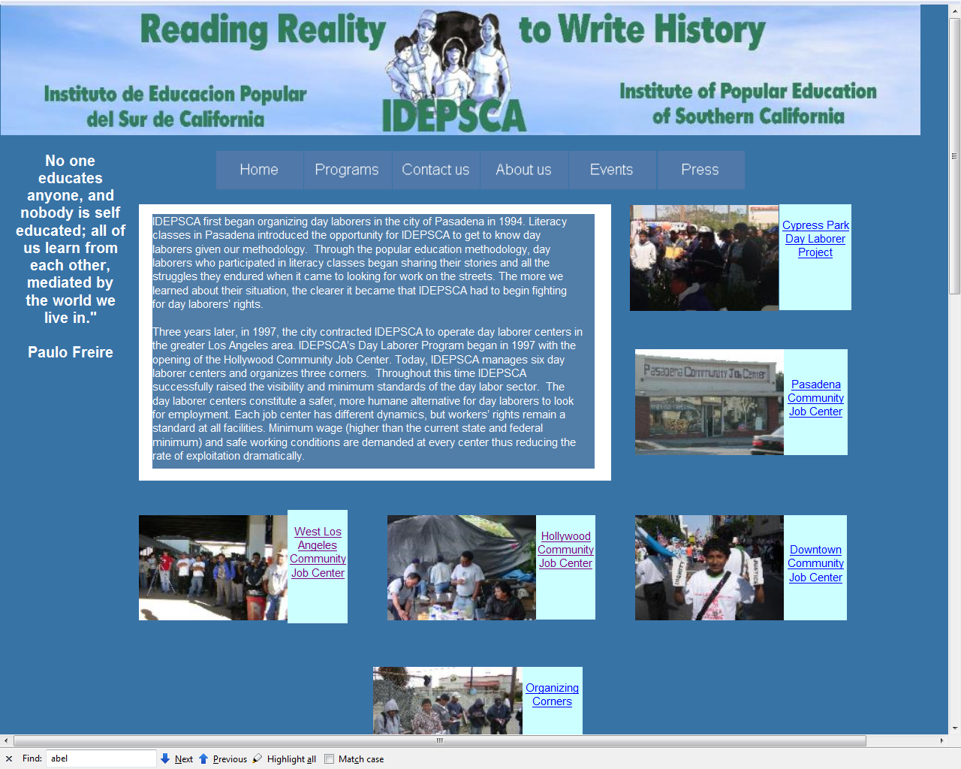

Slide 5
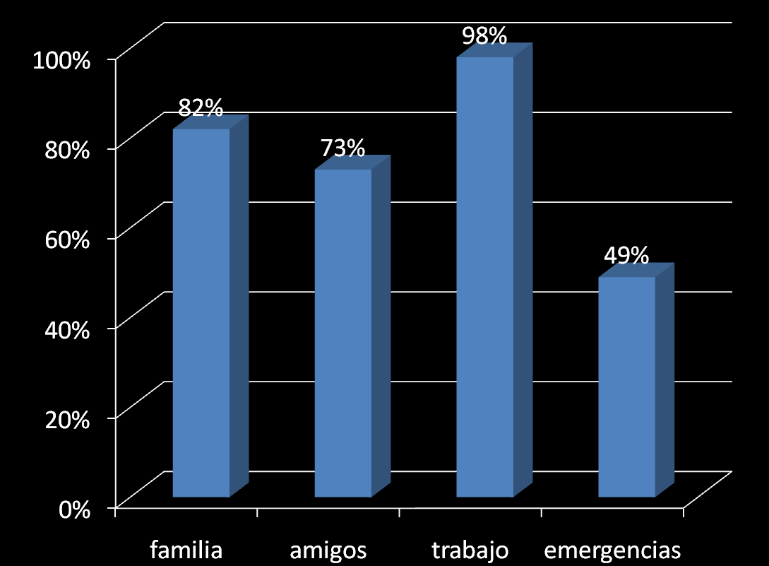
We surveyed 58 day laborers in 5 worker centers
78% have a cell phone, 29% use a pre-paid plan
Phone expenses vary between $20-$180 /month – with 50% paying less than $50/month
Notes:
5

Slide 6
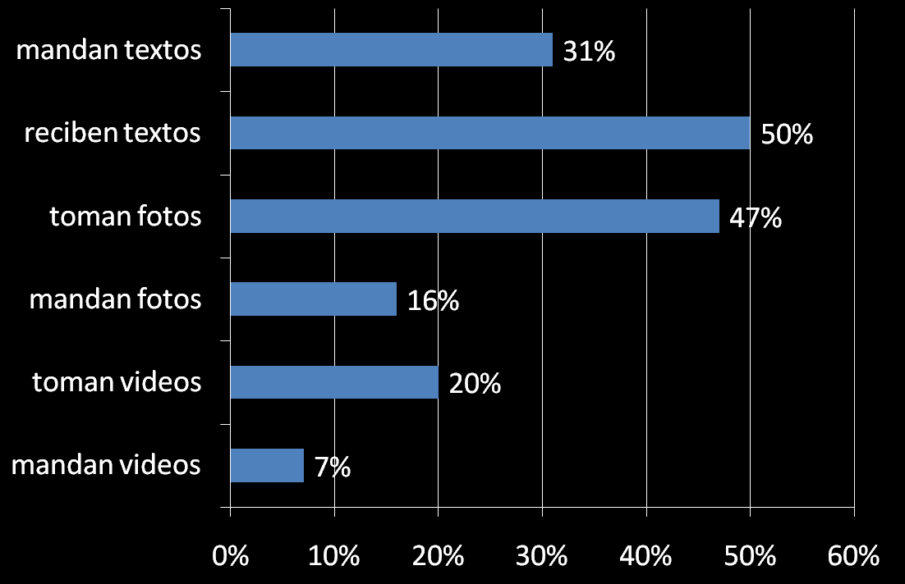
What features do they use?

Slide 7

First Steps
community application for IDEPSCA
affordable ICT access
create economic/social opportunities
Brainstorm various usage scenarios
inspiration: zexe.net Sao Paulo, Barcelona, Geneve
annotated city
mobile labor market
mobile storytelling
Initial approach
Look for low cost internet-enabled phones
(Boost Mobile)‏
open source, generic tools
  Content Management System
  Handset clients

Slide 8
participatory prototyping

Slide 9
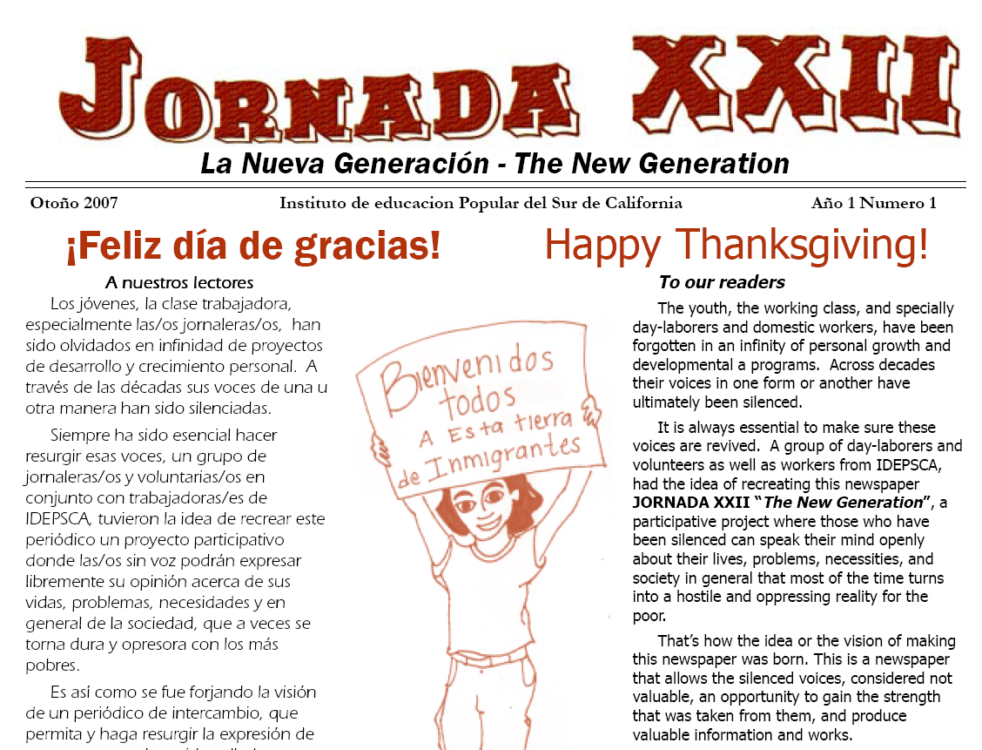

Slide 10
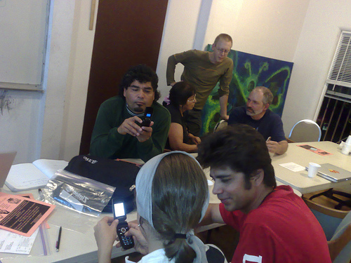
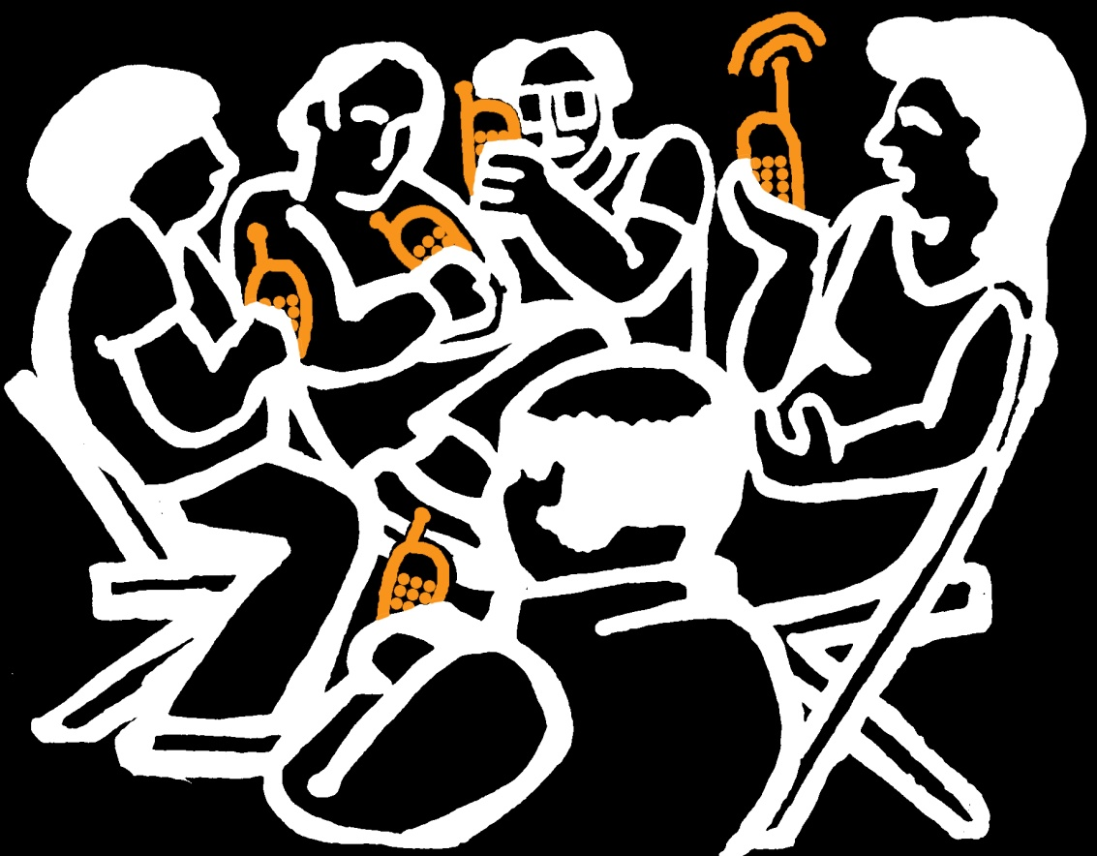
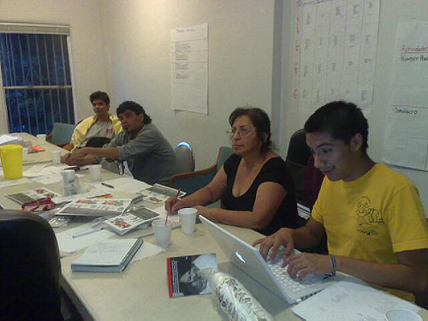
Weekly workshops with
members of the
popular communication team

Slide 11
Storytelling – with mobiles
tell the story
voice-mail radio
- show it.
photo-reporting
pictures and sound
slide shows
movies

Slide 12



Storytelling: say it.
Voicemail – to –blog
  Gcast -> RSS
  call 1-888-65-GCAST (888-654-2278); a voice will ask you for the number of the phone you registered with; enter 888-8-VOZMOB (888-886-9662); it will ask you for a 4 digit pin; enter 8888 record something. then press # [all in english].
  Gizmo -> email -> drupal
    one number, message in Spanish, post to blog
  Next step: asterisk + drupal

Slide 13


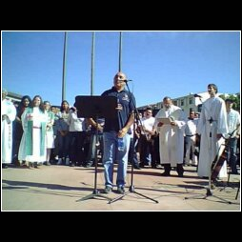
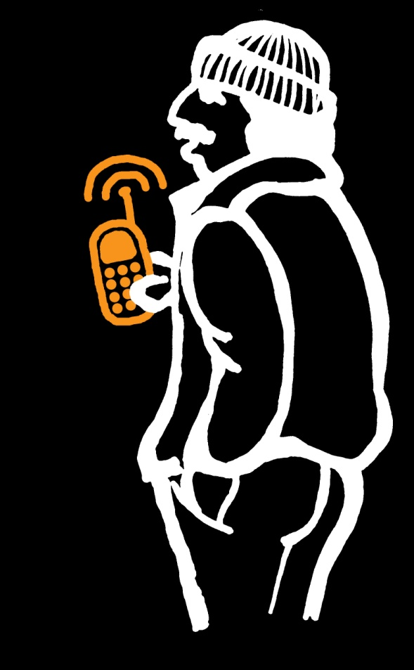
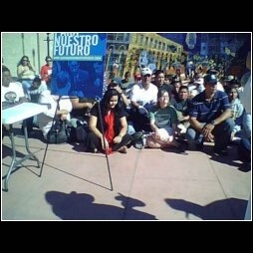
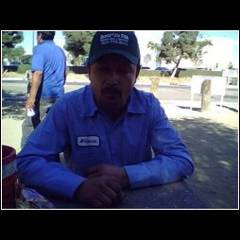

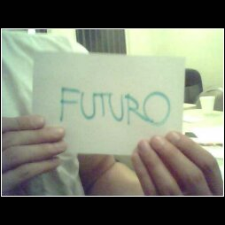
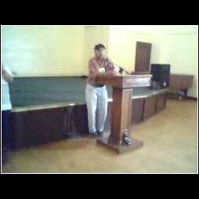
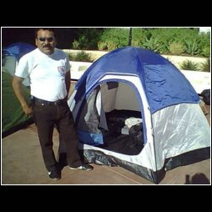
Storytelling: show it.

Slide 15
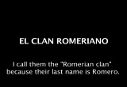
Storytelling: slide shows / movies

Slide 16
system features

Slide 17

Uploads from phone
cheap: any phone, pre-paid,
MMS bundles
easy: voice, text, mms
private: ?? (*67?)‏

Slide 18
Each phone has a different way to create MMS
Each carrier does it differently: Boost, Verizon, ATT
Uploads from phone
cheap: any phone, pre-paid,
MMS bundles
easy: voice, text, mms
private: ?? (*67?)‏

Slide 19
Anonymous, disposable
Cost-control
Uploads from phone
cheap: any phone, pre-paid,
MMS bundles
easy: voice, text, mms
private: ?? (*67?)‏

Slide 20
Uploads from phone
cheap: any phone, pre-paid,
MMS bundles
easy: voice, text, mms
private: ?? (*67?)‏
callerID hard to control
Cached information in many places

Slide 21
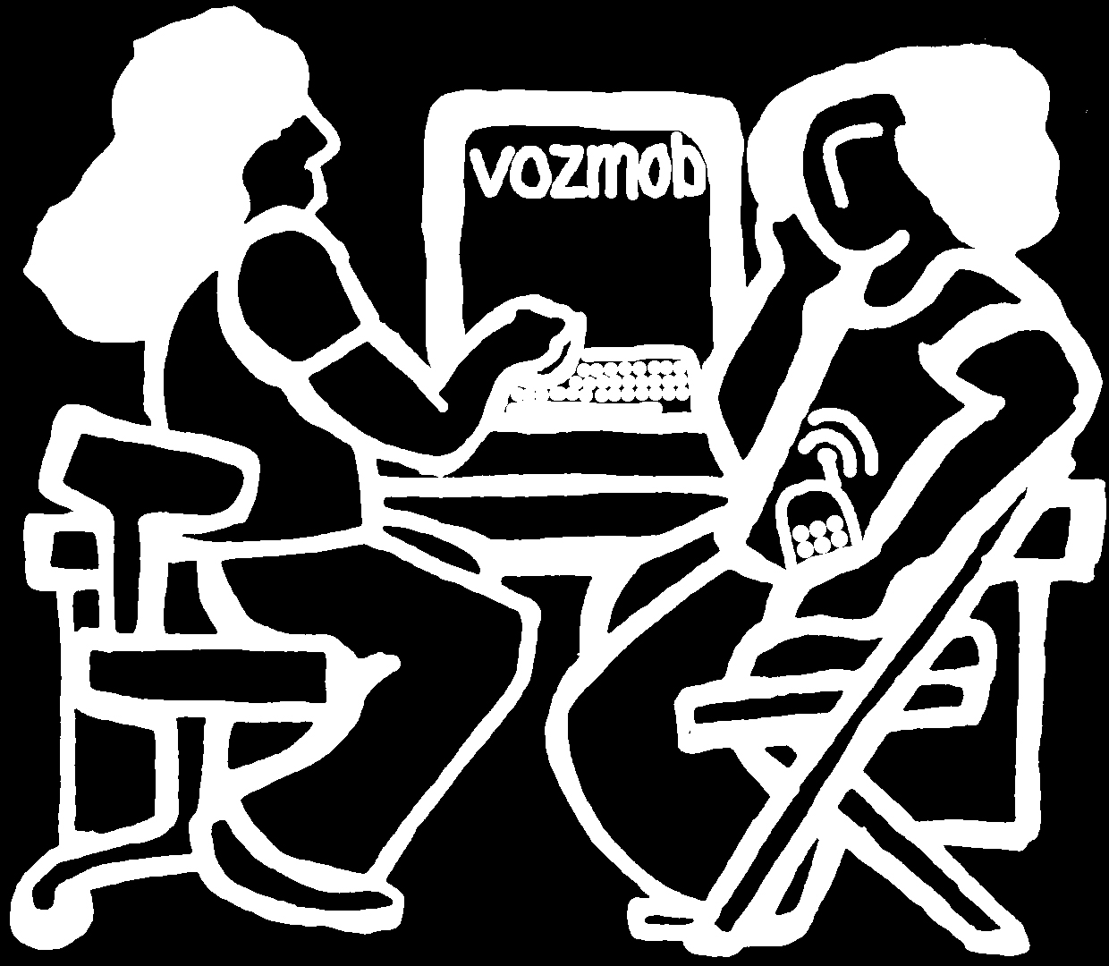
edit
expand
tag
translate
subtitle
re-use
re-mix (jquery)‏
personal pages
Content management system
customizable: open source
multimedia: voice, text, pictures...
private: strip identifiable info

Slide 22
Send to phones
push: sms, mms,…
pull: shortcodes
alerts
distribution lists
msg of the day
instructables
etc…

Slide 23
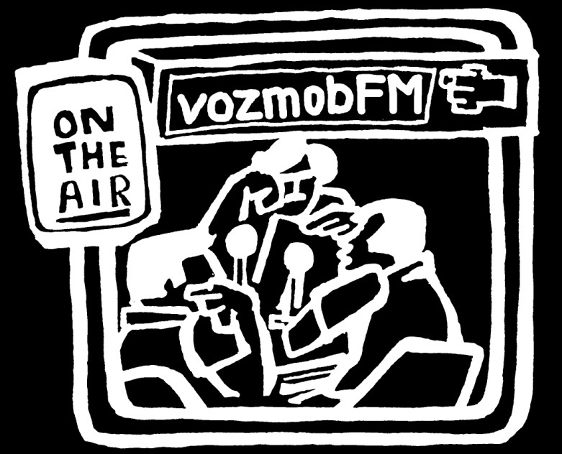
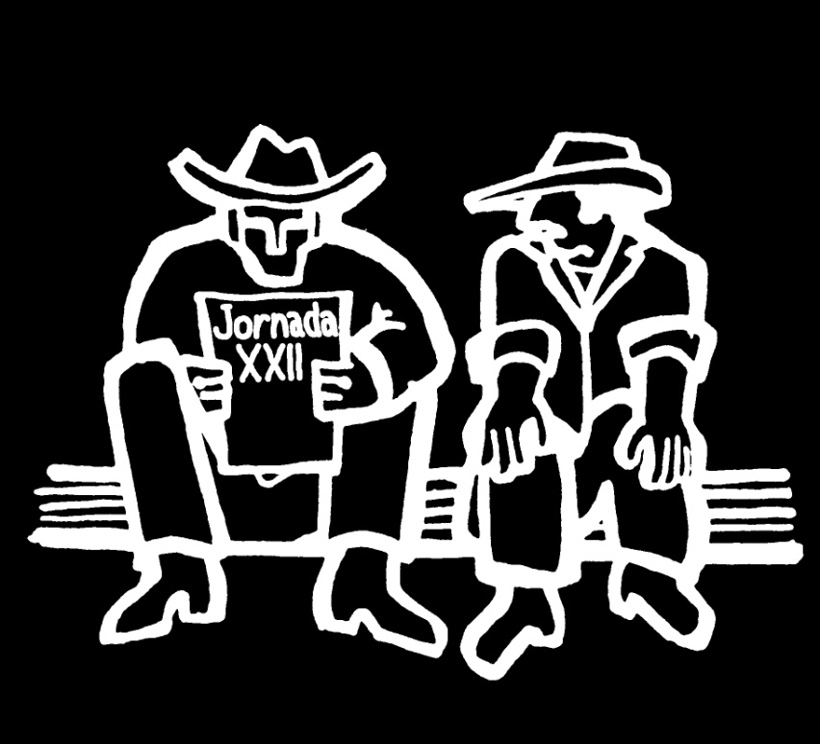
Universal design
multiple outputs
many inputs?

Slide 24
open research

Slide 25
http://prueba.vozmob.net - sandbox test site
http://blog.vozmob.net - research blog
http://wiki.vozmob.net - project wiki
http://class.vozmob.net - USC class wiki
http://tags.vozmob.net - del.icio.us tags for ‘vozmob’
http://list.vozmob.net - project mailing list
http://devlist.vozmob.net – development mailing list archive
http://dev.vozmob.net/projects/show/vozmob - bugs, features requests
http://code.vozmob.net - code repository
irc: http://irc.freenode.net #vozmob

Slide 26
next steps

Slide 27


end ’08: consolidate
complete design
learn the tools
test & showcase

Slide 28
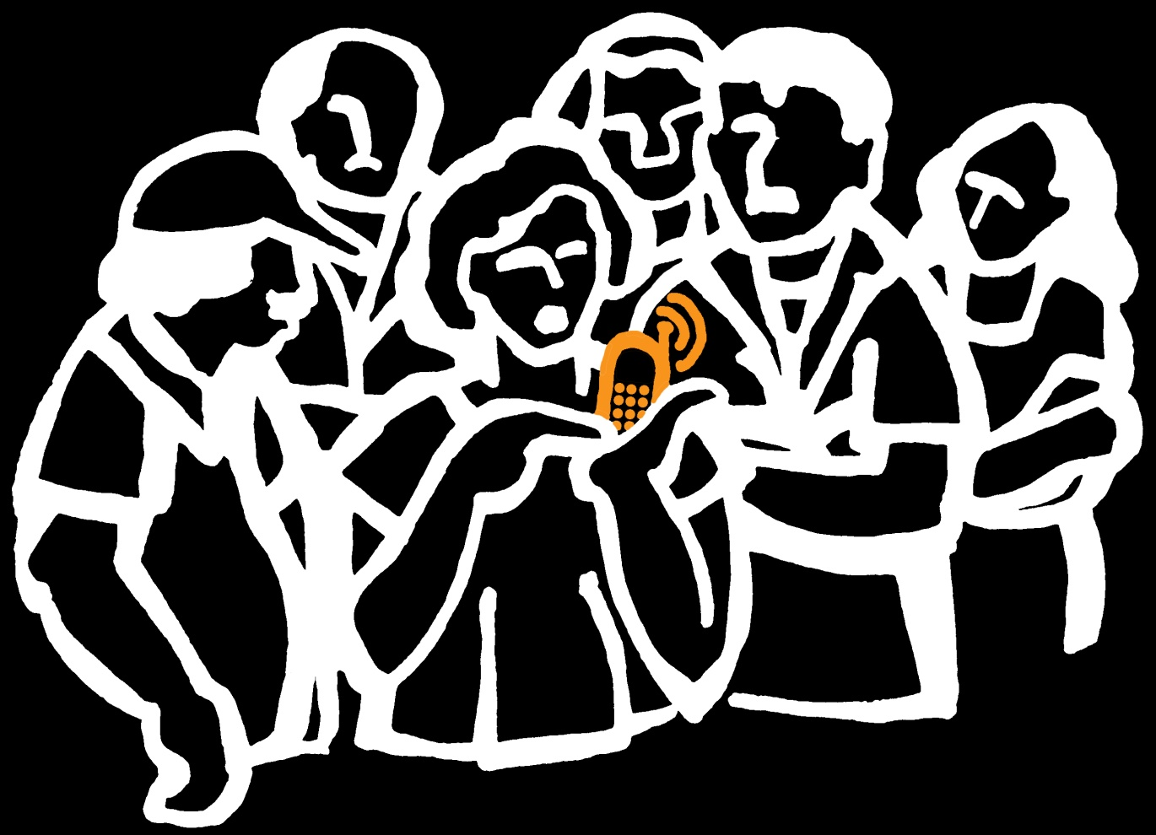
spring ’09: extend
deploy within IDEPSCA
train other users
revisit design
fall ’09: distribute
vozmob-in-a-box

Slide 29
research

Slide 30
suppliers
roll-out technology
users adopt
reject
users
appropriate
users baroquize
creolize
cannibalize
suppliers
re-claim
suppliers co-opt
adapt
block

Slide 31
suppliers
roll-out technology
users
appropriate

Slide 32
suppliers
roll-out technology
users
appropriate
what is possible with cheap technology
phones as gateway technology
evaluate participatory design process
storytelling’s role in community building
assess impact (individual, IDEPSCA, beyond)‏
examine surprises

Slide 33
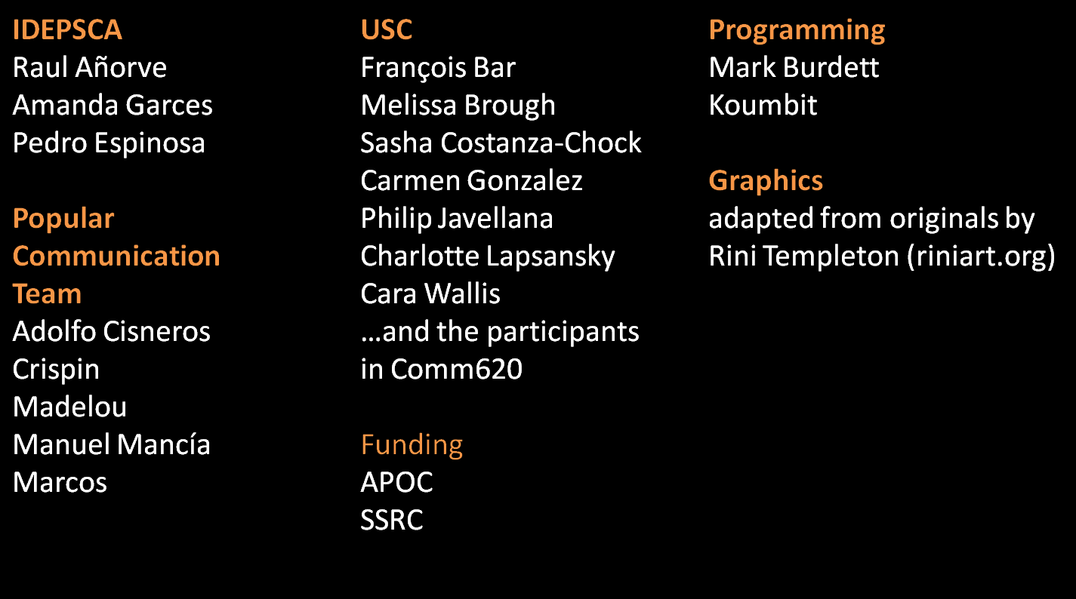

credits
http://vozmob.net

