Slide 1


Adaptive Leadership
Ceren Ozer
June 3, 2015
World Bank-Annenberg Summer Institute
In Reform Communication
University of Southern California, Los Angeles, CA
Collaborating to achieve collective results

Slide 2
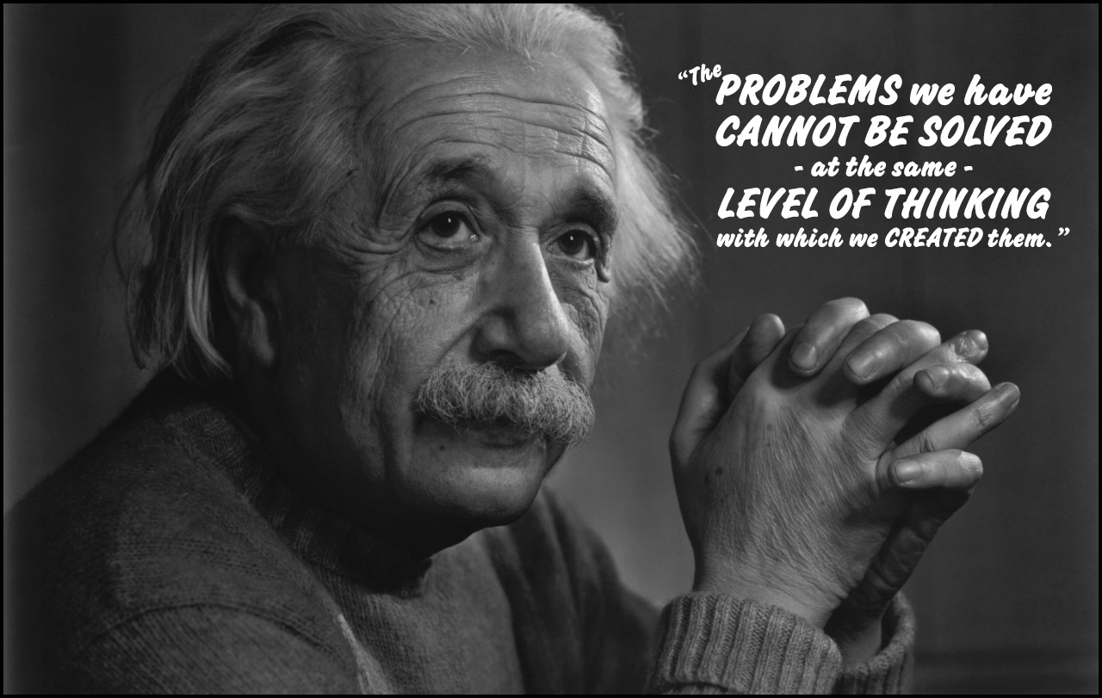
Notes:
Complex problems require seeing the whole not just its parts
Recurring problems which are made worse by past attempts to solve them
When there are no obvious solutions

Slide 3
The Blind Spot of Leadership
Results:
What
Process:
How
Source:
Who
Blind Spot: Inner place
from where we operate
Notes:
Quality of the system is a function of the quality of the people internal in the system

Slide 4
“The success of an intervention depends on the interior condition
of the intervenor.”
William O’Brien,
former CEO of the Hanover Insurance Company

Slide 5
A musical exercise!

Slide 6

Leading by Listening: The four levels of listening and dialogue
LISTENING 1:
from habits
Downloading
habits of judgment
reconfirming old
opinions & judgments
LISTENING 2:
from outside
Factual
listening
noticing
differences
Open
Mind
disconfirming
[new] data
seeing through
another person‘s eyes
emotional connection
LISTENING 3:
from within
Empathic
listening
Open
Heart
LISTENING 4:
from Source
Generative
listening
(from the future
wanting to emerge)
Open
Will
connecting to an
emerging future whole;
shift in identity and self

Slide 7
Field:
Structure
Of Attention
Field
1
Downloading:
Talking nice
Speaking from what they want to hear
Polite routines, empty phrases
Autistic system (not saying what you think)
I-in-me
2
Debate:
Talking tough
Speaking from what I think
Divergent views: I am my point of view
Adaptive system (say what you think)
I-in-it
Speaking from seeing myself as part
of the whole
From defending to inquiry into viewpoints
Self-reflective system (reflect on your part)
3
Dialogue:
Reflective inquiry
I-in-you
  Speaking from what is moving through
  Stilness, collective creativity, flow
  Generative system
  (identity shift: authentic self)
4
Presencing:
Generative flow
I-in-now

Slide 8
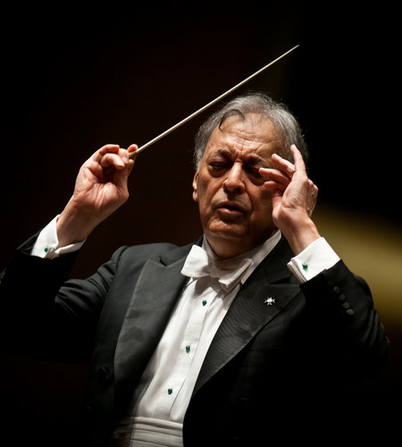
Leading through Listening

Slide 9
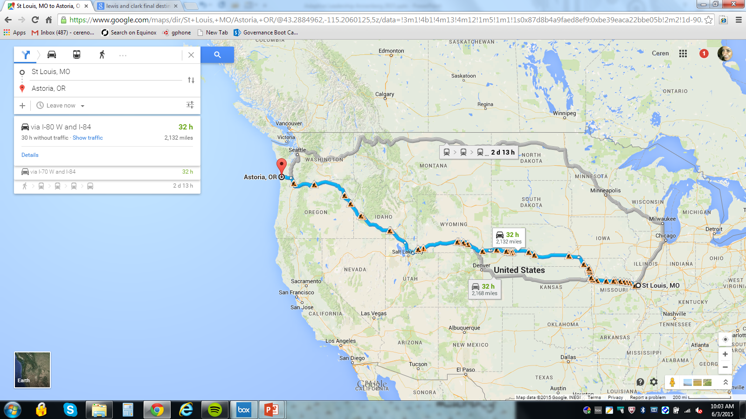
Let’s take a trip

Slide 10
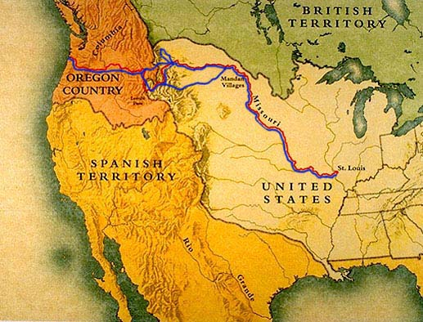
What if we were to do this trip 200 years ago?

Slide 11
Technical Problems
The necessary knowledge about them already has been digested and put in the form of a legitimized set of known organizational procedures guiding what to do and role authorizations guiding who should do it.

Slide 12
Adaptive Challenges
No adequate response has yet been developed. They require learning to overcome the conflicts in values, or reduce the gap between the espoused values and reality.
They require changes in values, attitudes or habits of behavior.

Slide 13
Distinguishing Technical from Adaptive Challenges
 | What’s the Work? | Who does the work?
Technical | Apply current know-how | Authorities Experts
Adaptive | Learn new ways | The people with the problem

Slide 14
Why the distinction is important?
What happens when we face an adaptive problem and we treat is technical one?

Slide 15
Key Lessons
The exercise of leadership is a voluntary activity.
One can exercise leadership from any position.
Because leadership is an activity NOT a position, it’s a time bound intervention: its episodic.
It implies asking questions more than providing answers.
The heart of the strategy is to center people’s attention in complex and difficult issues instead of in distractions.
Its development requires a learning strategy.

Slide 16
"The true journey of discovery
does not consist in searching
for new territories
but in having new eyes.”
Marcel Proust

