Slide 1
Managing Conflict Effectively
Gail Fann Thomas, Assoc Professor
Graduate School of Business & Public Policy
Program Manager, Strategic Communication
Center for Executive Education
Naval Postgraduate School
Monterey, CA
gthomas@nps.edu
Allison Noyes Soeller, PhD
Annenberg School of Communication
Children’s Hospital Los Angeles
University of Southern California
Los Angeles, CA
anoyes@usc.edu

Slide 2
Learning Objectives:
Discuss the 5 conflict-handling behaviors and know when each is appropriate to use.
Identify your preferred conflict-handling mode and know the consequences of over- and underuse of each mode.
Discuss the basics of principled negotiations.
From your work experience, provide examples of collaborative/integrative negotiation.

Slide 3
Some Definitions
Conflict A situation in which the concerns of two people appear to be incompatible.
Negotiations A dialogue between two or more people or parties, intended to reach an understanding, resolve a point of difference, or to produce an agreement upon courses of action.
Mediation Using a third neutral party (mediator), parties talk and generate a mutually acceptable agreement. The mediator has no decision power.
Arbitration Similar to a legal hearing, where both parties present information regarding their positions and a third-party neutral arbitrator makes a decision to resolve the dispute.

Slide 4
Conflict, managed well, can improve outcomes.
Creative conflict management is about making better decisions.

Slide 5
Conflict handling is useful at different levels
Interpersonal
Groups/Teams
Organizational (culture)

Slide 6
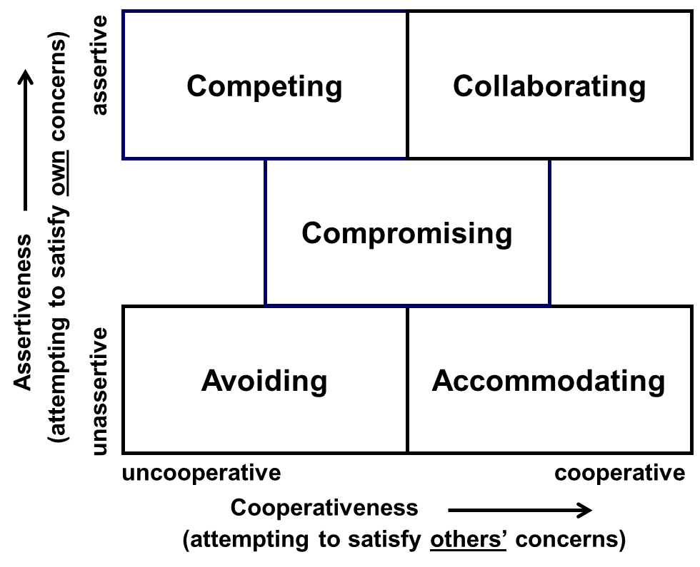
Model of Conflict-Handling Modes
*Adapted from: Kenneth W. Thomas, “Conflict and Conflict Management,” in the Handbook of Industrial and Organizational Psychology, 1976.

Slide 7
Distributive Dimension of Conflict–Handling Behavior:
Claiming Value
Competing
Compromising
Accommodating
These modes assume a limited “pie” of total possible satisfaction – enough to fully satisfy one person
They differ in terms of how much of that satisfaction is claimed (shaded portion of pie)

Slide 8
Integrative Dimension of Conflict–Handling Behavior:
Creating Value
Collaborating
Compromising
Avoiding
Along this dimension, the modes differ in terms of the size of the pie of total possible
satisfaction
Collaborating seeks to enlarge the pie to completely satisfy both persons’ concerns.

Slide 9
“Pies of Satisfaction”
Collaborating
Competing
Compromising
Assertiveness
Avoiding
Accommodating
Cooperativeness
Satisfaction you intend for yourself
Satisfaction you intend for other

Slide 10
Your TKI Conflict-Handling Modes
N=25

Slide 11
TKI COMPARISON DATA
Average Mean Scores
 | WBI 2015 | NORM GROUP** | EXECS
Competing | 4.24 | 4.78 | 5.05
Collaborating | 5.68 | 6.45 | 6.80
Compromising | 8.28 | 7.35 | 7.58
Avoiding | 5.88 | 6.02 | 5.42
Accommodating | 5.92 | 5.39 | 5.16
N=25 Institute participants
**Comparison data from Conflict Styles of Men and Women at Six Organization Levels, Kenneth W. Thomas, Gail Fann Thomas, Nancy Schaubhut, International Journal of Conflict Management, 2008. (n=2400)

Slide 12
 | Competing | Collaborating | Compromising | Avoiding | Accommodating
1 | 11 | 3 | 3 | 9 | 4
2 | 5 | 12 | 3 | 7 | 3
3 | 0 | 0 | 10 | 10 | 10
4 | 6 | 6 | 6 | 6 | 6
IDENTIFY ADVANTAGES AND DISADVANTAGES
OF EACH PROFILE

Slide 13
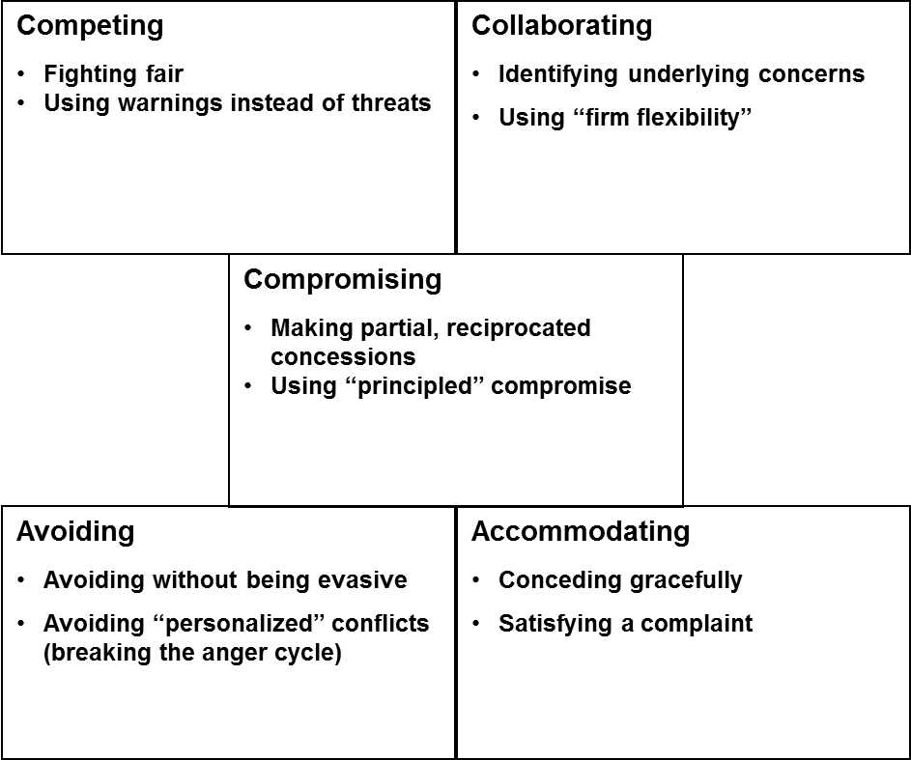
Behavioral Skills for Each Conflict Mode
(Partial List)

Slide 14
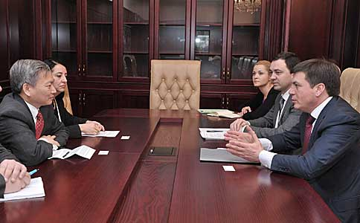
ORGANIZATIONAL CULTURE
How would you characterize the conflict handling culture in your organization (e.g. World Bank)?

Slide 15
Principled Negotiation: 4 things to remember
Separate the person from the problem
Focus on interests, not positions
Invent options for mutual gain
Insist on using objective criteria
Source: Fisher & Ury, 1991

Slide 16

Collaboration Requires Knowing the Difference between Concerns and Positions
Concern: What you care about in a conflict; the thing that’s threatened that you would like to protect.
Position: The action you propose to settle the conflict;
what you think should be done.

Slide 17
Principled Negotiation: Steps for Preparing a Meaningful Dialogue
My Interests | Their Interests | Options | Objective Criteria
What do I really care about? What are my underlying concerns? | What do I think they really care about? What might be their underlying concerns? | What are possible collaborative agreements we might make? | What external criteria might we use to demonstrate fairness?
outcomes
BATNA
What’s my Best Alternative to a Negotiated Agreement? At what point should I walk away?
Commitment
What’s our commitment to each other? What is our plan of action?
Source: Getting Ready to Negotiate, Fisher and Ertel, 1995.

Slide 18
IDENTIFYING INTERESTS AND POSITIONS
Position = What I want Interest = Why I want it
Example:
 | Position | Interest
Program Manager | I need an extension on project deadline. | We ran into a glitch and I had already promised the lead analyst vacation time. I want to uphold my promise to her.
PM’s Boss | I want the project done on time. | The donors and my boss are expecting the project to be done on time. The organization’s/my reputation will be tarnished.
What’s a collaborative solution to this problem?

Slide 19
Exercise: Collaborative Negotiations
CHOOSE A PARTNER AND SHARE A REAL CONFLICT SCENARIO THAT YOU HAVE EXPERIENCED. (2 MINUTES EACH)
BE PREPARED TO SHARE YOUR INSIGHTS WITH THE CLASS.
Describe a conflict that you observed or participated in that was resolved collaboratively. (the pie was made bigger)
OR
Think of a conflict that was not resolved well. How might it have been more successful had you used these principles?

Slide 20
Summary
Remember:
  Collaborate when you can on important issues
  Don’t push a position unless you must
  Use dialogue, “squint with your ears”, check assumptions, & know yourself
Notes:
Summing up, then, creative managers use their assertiveness to set up creative problem solving on important issues. Show slide: “Summary. Creative managers try to manage conflict by: collaborative problem solving on important issues; not imposing their positions unless necessary; using firm flexibility to set up problem-solving when resistance occurs.”

Slide 21
Backup slides

Slide 22
Motives Often Get Misread
Team members often stereotype other styles at their worst, framing them negatively in terms of their own values.
COMPETITOR
May see accommodator as:
  Nicey-nice
  Losing out
  Timid or weak
COLLABORATOR
COMPROMISER
AVOIDER
ACCOMMODATER
May see competitor as:
  Insensitive
  Selfish
  Bullying
© 2011, CPP, Inc. All rights reserved
22
Notes:
22

Slide 23
Positive Intentions of the Conflict Styles
Competitor
“Champion”
Here’s a good thing to do!
Collaborator
“Problem Solver”
Can we find a win/win solution?
Compromiser
“Pragmatist”
Should we settle for a workable middle ground?
Avoider
“Time Keeper”
Is this issue worth our time?
Accommodator
“Chaplain”
Can we protect goodwill and others’ well-being?
© 2011, CPP, Inc. All rights reserved
23
Notes:
23

Slide 24
Style “Temptations” to Guard Against
(Partial List)
Competitors
Not listening: interrupting, talking over, or ignoring others’ statements
Attacking: showing anger; making personal criticisms or threats
Collaborators
Overanalyzing: problem solving when the answer is clear or the issue is unimportant
Flailing: continuing to problem solve when it’s not working
Compromisers
Posturing: using misrepresentation or inflated demands to get a favorable settlement
Settling short: agreeing to a compromise that does not meet team needs
Avoiders
Avoiding teammates: avoiding individuals with whom you have issues; not returning e-mails, calls, etc.
Withholding information: not volunteering information on issues; providing vague answers
Accommodators
Allowing questionable decisions: not challenging decisions you have doubts about; not “rocking the boat”
Bending rules: allowing exceptions to rules or standards; overlooking violations or substandard performance

