Slide 1
Envisioning the Future: Consulting Part 2
Patti Riley and Gail Thomas

Slide 2
Objectives
To use scenarios to build the capacity for foresight
This is key for putting communication at the center
Also critical for consulting
To understand how narratives are tools for reasoning
To think of storytelling visually

Slide 3
SCENARIOS HELP ORGANIZATIONS BUILD

Slide 4
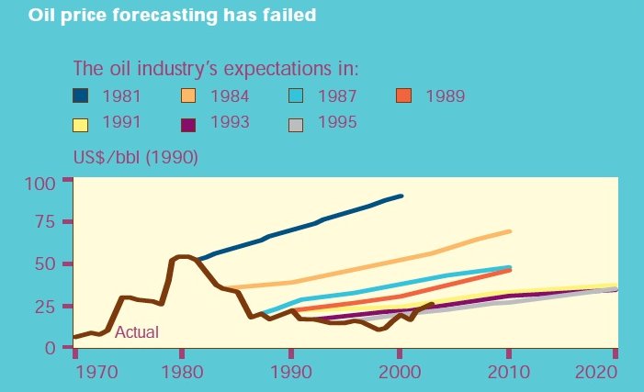
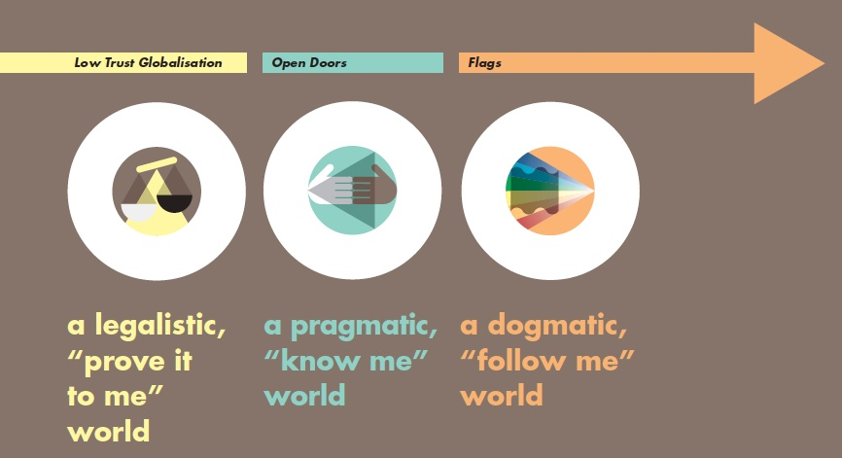
M
Energy Industry Hires People
Good at Foresight

Slide 5
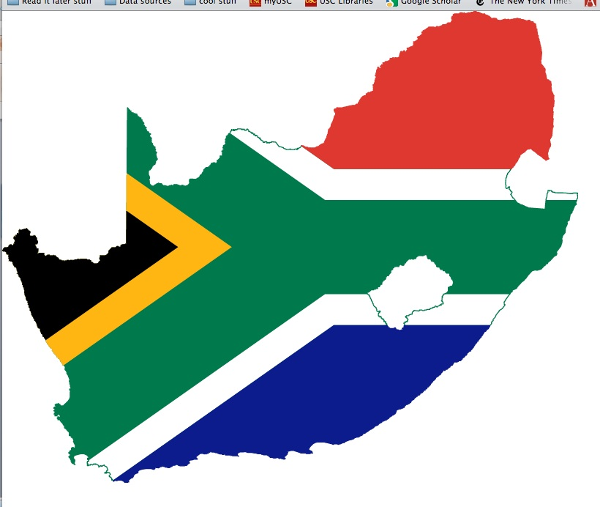
M
Famous Example on Political Will

Slide 6
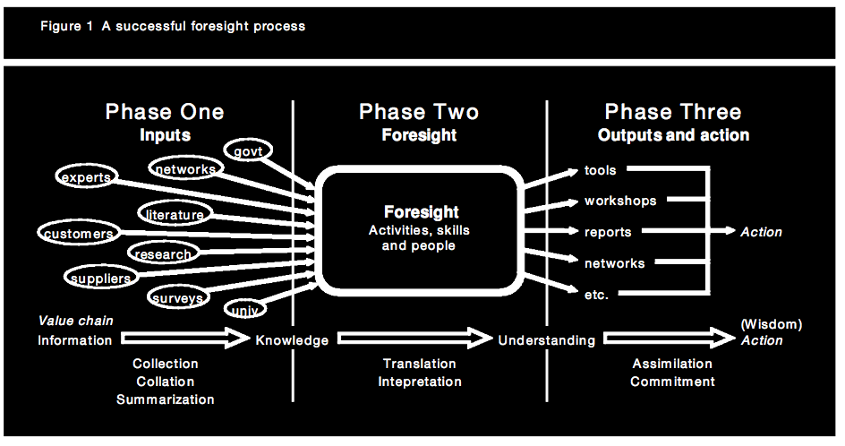
Traditional Foresight Process
Horton, 1999

Slide 7
M
USC Annenberg Scenario Lab
uscscenariolab.com

Slide 9
Scenarios “Lessons Learned”
Making sense of multiple futures is hard
Short-term approach creates blind spots in foresight
Need to set a date that is far enough in the future to allow people to break free of present roles and structures
People will change their perspectives
Having the scenario development process be open to all participants seems to encourage more detailed stories of the future
Tendency for positive local stories and pessimistic stories in larger institutions or networks
Storytelling skills are critical

Slide 10
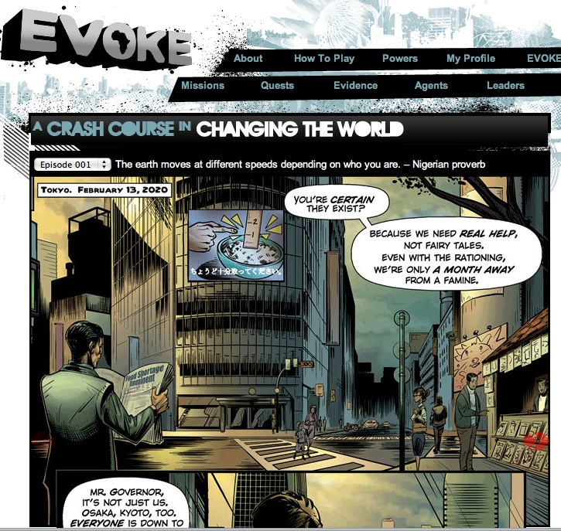
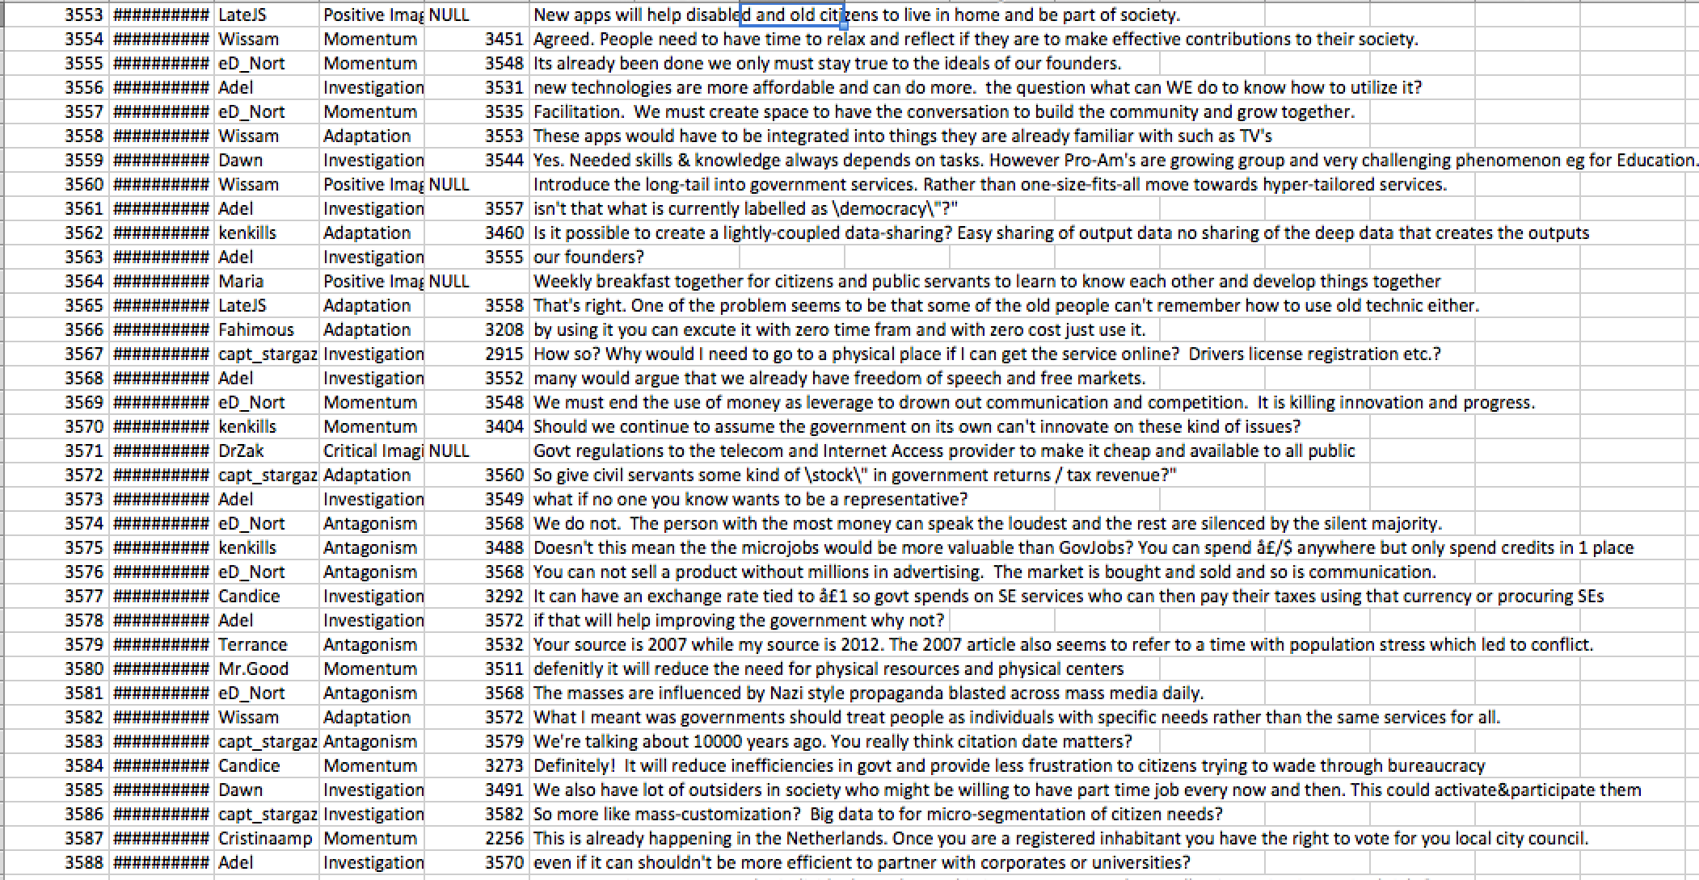
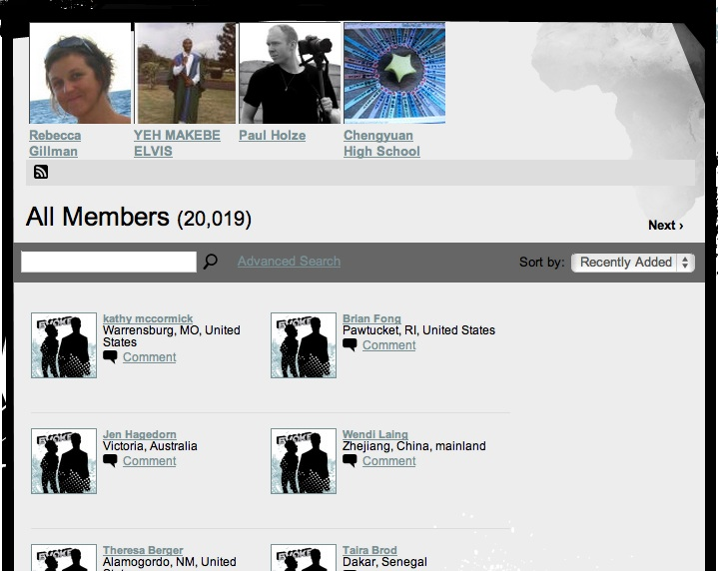

Slide 11
If You Want People to Think and Behave Differently, Tell them a:
STORY

Slide 12
Research on Narratives
People reason through stories—the narrative paradigm (Walter Fisher, Hollihan & Riley)
People are storytelling creatures--hardwired
Stories can both illuminate and obscure facts
Stories are judged on their:
Fidelity—Does the story sound true given my life experiences?
Coherence—Does the narrative hang together? Do the people in the story behave in ways that make sense?

Slide 13
Powerful Scenarios: Think Like a Movie Director or a Journalist
Compelling narratives embody plot (action agenda), characters with a motive (inventors, leaders, coalitions), and surprise plus emotions
Helps to have great audio and visuals
People often have to learn how to tell great stories
Modified for stakeholders
Honed in interaction

Slide 14
Directors Know A Great Story is:
A Promise
People have to work to get it or it won’t be interesting
Incomplete
Motivational
Well Crafted
2+2 = ?

Slide 15
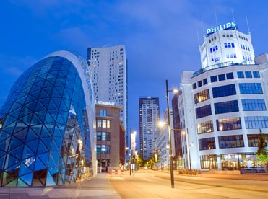
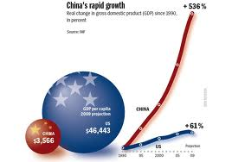
Set the Scene: It is 2025!
The whole international system—as constructed following WWII—will be revolutionized. Brazil, Russia, India and China have a seat at the international high table, bringing new stakes and rules of the game
There will be ~ 8.1 billion people
Sustainability is key to national strength
1.8 billion people still live in areas plagued by water scarcity

Slide 16
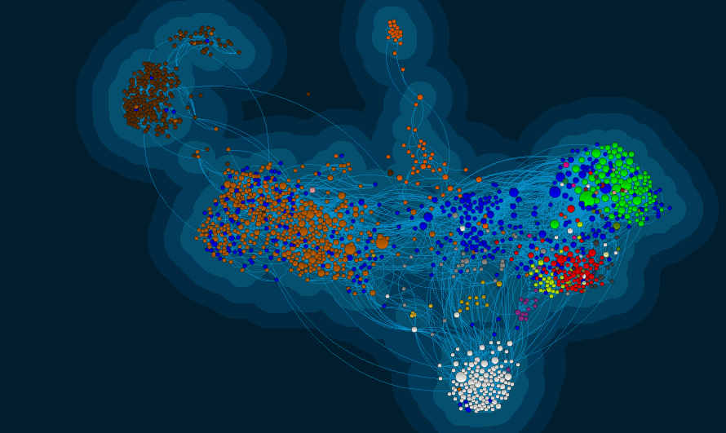
2025 is about Connections
Mobile, wearable and soon, even implantable technologies make it possible to experience “augmented realities” on a daily basis
The increasingly digital economy creates even deeper structural unemployment for low-skilled workers

Slide 17
The Future Has “Drivers”
Drivers “pushing” the future
Innovations in ICTs
Large and growing youth population
Corruption, debt in many countries, high unemployment
State controlled media and information systems
Unstable/volatile political systems
Climate change
Depopulation of rural areas
Low investment in infrastructure

Slide 18
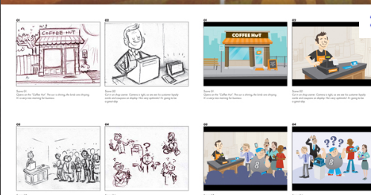
Exercise
Tell your story in scenes
The Vision is actually the first scene where the story is new and different
The second scene is often a contest of competing frames that define the tough, needed changes
Who will win? And Why?
The third scene is about aligning goals—is the line of sight to the Vision clear?
Strategy????
STORYBOARD
10 word limit

Slide 19
The Future???

