Slide 1




Assessing change in attitudes, awareness and behavior:
A multi-method communication approach to
counter human trafficking in Indonesia
Patricia Riley, PI
Prawit Thainiyom, Co-PI
Sheila Murphy, Co-PI
Mark Latonero, Co-PI
June 10, 2015
Notes:
Global or international?

Slide 2
Human trafficking is a phenomenon where human beings are transported to other countries or regions for economic exploitation
12.3 MILLION EXPLOITED*
64% economic EXPLOITATION
11% SEXUAL
EXPLOITATION
*Average of numerous studies (2.45 million up to 27 million
BROTHELS
Massage parlours BARS
SEX tourism
Agriculture
manufacturing
Domestic service
FISHING INDUSTRY
4.2% CHILDREN
Notes:
12.3 million people are estimated to be victims of trafficking & forced labor and over 77% are located in Asia (ILO, 2006).
Human trafficking generates over US$32 billion every year (ILO, 2005).
Health significance: Victims of trafficking are susceptible to physical violence, sexually transmitted diseases, HIV/AIDS, drug addiction, depression and post-traumatic stress disorder (Feingold, 2005; Zimmerman, et. al., 2006; Department of State, 2007).

Slide 3
Northern America & Western Europe:
360,000 people
Middle east and North Africa:
260,000 people
Almost 80% of those exploited come from the Asia Pacific. The rest are primarily found in countries with oppressive governments.
US
Question for applied communication scholars:
What geographic areas should be strategically targeted for communication campaigns?
Human trafficking around the world
= Tier 1
= Tier 2
= Tier 2 Watch list
= Tier 3
Asia Pacific:
9.5 million people
Latin America:
1.3 million people
Sub-Saharan Africa:
660,000 people

Slide 4
Human trafficking may manifest itself differently but there are common themes
Human Trafficking Trajectory
Recruitment
Exploitation
Escape
Traffickers target the vulnerable: children, youth, ethnic minorities & undocumented migrants
Recruited through placement agencies, acquaintances, and sometimes relatives.
Travel to distant locations--within country/across borders
Identification documents taken, or use of force and violence; debt bondage; threats of deportation; harm to relatives
Potentially exposed to: STDs, HIV/AIDS, abuse, mental trauma or death
Community members call hotline
NGO investigations
Police raids
People leave/ escape and seek services
Try to reintegrate into society
Question: How to develop research to shape intervention strategies, campaign goals, audience and story-telling to match the local context?
Notes:
Greater migration enabled by open borders and globalization caused the industrialization of societies that has moved jobs towards urban centers
Growing economic inequality leads many to move seeking work to escape poverty. Only in the past two decades was modern-day slavery really diagnosed as a global problem
And the passage of the Trafficking in Persons Act in 2000 by the United Nations led to an increase in government focus on the issues of human trafficking.

Slide 5


Preventing Human Trafficking
Governments, international and local organizations conduct programs to communicate with at-risk populations
Implemented like public health communication campaigns, projects target large numbers of people through a series of activities (concerts), communication and media channels (Rogers and Storey, 1987)
Example of anti-trafficking program is MTV EXIT Campaign--$108 million invested to educate millions of households in Asia since 2006 (USAID, 2012)
Problem: A meta-analysis study of 48 health promotion campaigns, shows, on average, a modest 7-10% effect on behavioral change (Snyder, 2001)

Slide 6
Challenges of Human Trafficking
Prevention Campaigns
Lack of use of behavior change communication theories to guide the planning of anti-trafficking interventions
Lack of integration with entertainment/storytelling theories
Little documentation of the effectiveness of these interventions through standard scientific research methods
Little research on social media conversations about trafficking
Lack of translational research that bridges academic research to practice
Notes:
Van de Laan and his colleagues (2011) found only two out of 144 studies to evaluate awareness-raising programs that met some basic standards of scientific research methods.

Slide 7
Research Objectives
To design a communication system, behavioral survey that can help evaluate the effectiveness of human trafficking prevention and awareness-raising programs
To use qualitative interviews, focus groups and document analysis to generate empirical data on human trafficking in Indonesia and identify barriers and facilitators of knowledge, attitudes, and behaviors related to human trafficking
To analyze narratives on trafficking in social media, primarily Twitter (Indonesia is often called the “Twitterverse”)
To develop a network of CBOs, NGOs and IGOs who can better communicate and act together
To create a toolkit that practitioners can utilize to design, implement, and evaluate anti-trafficking programs

Slide 8
Research Questions
RQ1: What are the effects of the MTV EXIT documentary in shaping knowledge, attitudes, norms, efficacy, perceived risks, intention, skills and abilities, interpersonal discussion, and human trafficking prevention behavior?
RQ2: What factors at the…are significant determinants of human trafficking prevention behavior?
  individual level (age, gender, education, household income, prior experience with migration and trafficking, and media exposure to trafficking),
  interpersonal level (social influence to migrate, and migrant network),
  and community level (hotspots, and comfort level of human trafficking discussion in public spaces)

Slide 9
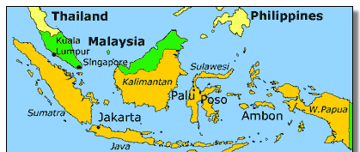
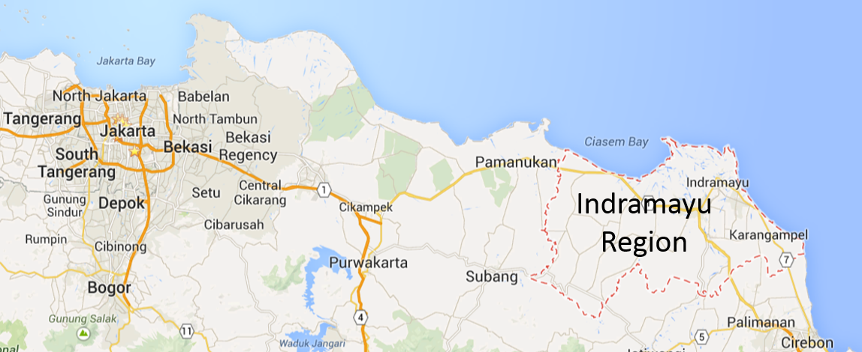
Methods: Project sites
Indramayu, West Java, Indonesia
1.77 million people (Indramayu District Government, 2014).
Highest number of victims (IOM, 2013)
Indramayu women migrate to urban cities (e.g., Jakarta) for commercial sex work and to Saudi Arabia, Taiwan, Hong Kong, Singapore for domestic work.
Indonesia

Slide 10
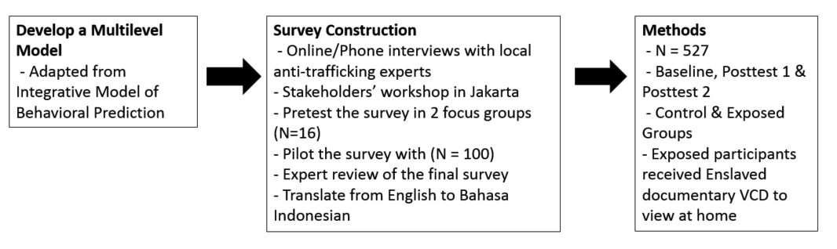
Methods: Survey research phases

Slide 11
Evaluating the Effectiveness of the Campaign
3 data collection points (baseline, post intervention 1 and post intervention 2) with control and exposed groups using a panel sample.
People who are exposed to the intervention
Before intervention
Post-intervention 1
Post-intervention 2
People who are not exposed to the intervention (control)
Before intervention
Post-intervention 1
Post-intervention 2

Slide 12

Campaign stimuli material

Slide 13
Synopsis for Enslaved
The Indonesian version of Enslaved is hosted by actress Dian Sastrowardoyo, a popular model and actress in Indonesia.
Enslaved narrates the stories of 3 everyday Indonesians who became victims of human trafficking
Siti, a woman who went to Malaysia to work as a maid but ended up getting abused by her agent and employers
Ismail, a man who went to Northern Sumatra and was forced to work in logging in the forest by the traffickers
Ika, a girl who was deceived into sex work in Batam
The documentary also demonstrates how Indonesians can protect themselves and their families from being trafficked, and highlight what everyone can do to prevent this crime.

Slide 14
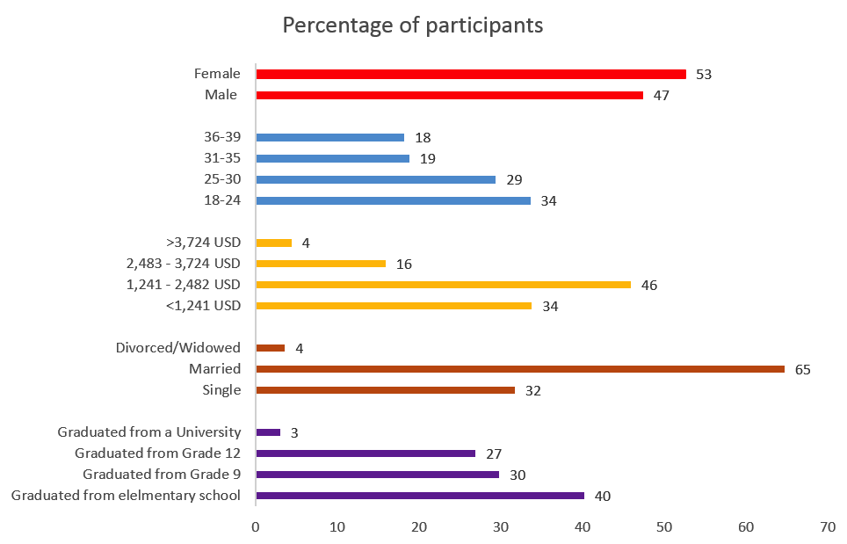
Characteristics of the participants
Gender
Age
Annual household income
Marital status
Level of education
Notes:
Ethnicity: 95% Javanese, 4% Sundanese
Upon closer examination of the categories under district and education, we did not find the percentage differences to be extreme and concluded that attrition should not greatly affect other statistical analyses in this study.

Slide 15
Results: Information Seeking Behavior

Slide 16
Results: Awareness of the terms

Slide 17
Results: Documentary effects
There were significant effects of the MTV EXIT documentary on the three outcome variables: knowledge, perceived risks, skills & abilities, and two limited effects on efficacy and intention.
The documentary’s effects were mostly diminished by the 4-month follow up as only perceived risks and intention variables could sustain the higher scores at a moderately significant level.
Notes:
Exposure to a mass media campaign alone would not have sustained impact in influencing a person to adopt the recommended behavior.
Interpersonal activities such as peer education, community organizing, and social support are necessary additional conditions to achieve behavior change.
Interpersonal level factors are the strongest determinants for changing trafficking related outcomes.

Slide 18
Results: Determinants of human trafficking prevention outcomes
Individual level
Demographic variables such as gender (0), age (2), household income (3), and education (1) are weak predictors.
Prior experience with trafficking (6) and migration (7), and media exposure to trafficking information (5) are strong predictors.
Interpersonal level
Influence on migration (7) and migrant network (6) are good predictors.
Community level
Hotspots (2) and comfortability in discussing trafficking issues in those hotspots (4) generate less meaningful association with trafficking prevention outcomes.
Notes:
It is worrisome to see participants with more experience with trafficking and labor exploitation to be less likely to possess knowledge, favorable attitudes, efficacy, and intention to perform preventive behavior.
The campaign should make careful efforts in addressing this at-risk population of the available resources and support they could access to prevent themselves from being re-trafficked. Nevertheless, experience with migration and media exposure were found to be facilitators of human trafficking prevention, indicating experienced migrants had more information, skills, and mindset to take precautionary measures to prevent themselves from becoming the victims of trafficking.
MTV EXIT could utilize this assets by focusing its message around reaching out to trusted peers and family members who have migrated safely for advice on trafficking prevention. Since interpersonal level factors are generally good predictors of anti-trafficking related outcomes, prevention campaigns should focus on utilizing existing migrant networks to encourage peer and familial discussions about the dangers of human trafficking and encourage safe migration steps to minimize risks.

Slide 19
Conclusions
The documentary had positive effects on prevention knowledge, perceived risks, skills & abilities, and limited effects on efficacy and intention to perform prevention behavior.
Prior experience with human trafficking and migration, media exposure to trafficking information, influence to migrate, and migrant network are strong determinants of trafficking prevention-related outcomes.
This study supports the inclusion of mass media campaigns in primary prevention strategies, and to utilize multi-level factors (e.g., from the Integrative Model; Fishbein & Ajzen, 2010) to identify determinants of prevention outcomes that can be incorporated into campaign messages.
Notes:
To our knowledge, this research project is one of the first evaluation studies of anti-trafficking campaigns that used a randomized experimental control trial design with longitudinal panel samples.

Slide 20
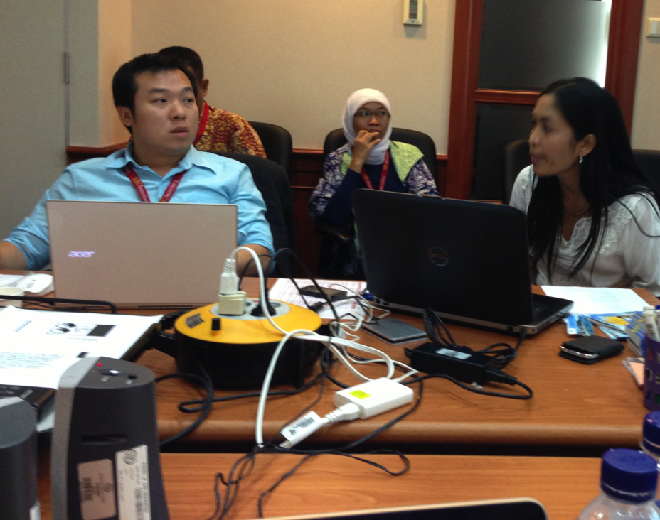
Future Plans
This project is a pilot study and we plan to look for funding to other countries
Launch the report
Implications for other preventive campaigns
We have initiated a collaboration with Vanderbilt University and Texas Christian University to create a Global Human Trafficking Survey to compare data across the world
Facebook on USC-NEXT

Slide 21
Questions?

