Slide 1
Metrics, Measures and Analysis
Patricia Riley, PhD
Director, Global Communication and Media
Director, USC Annenberg Scenario Lab

Slide 2
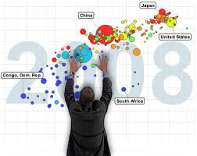
Objectives
Discuss possible approaches to monitoring and evaluation
Focus on communication metrics
Think about data visualization
Potential new analytical approaches
Create your own new metrics
2

Slide 3
What is Program Monitoring, Evaluation?
Monitoring is the routine process of data collection and measurement of progress toward program goalsobjectives.
Evaluation is the use of social research methods to systematically investigate the achievement of a program’s results

Slide 4
Data Collection
In practice, covers a wide range of activities and requires data collection, but data collection is not synonymous with monitoring
Monitoring also implies analysis and use of the data
Generally, the level that records information should be able to use it
Designing data collection systems with this principle in mind helps improve chances that the data will be collected carefully and put to good use use.
ires data collection, but data collection is not
4

Slide 5
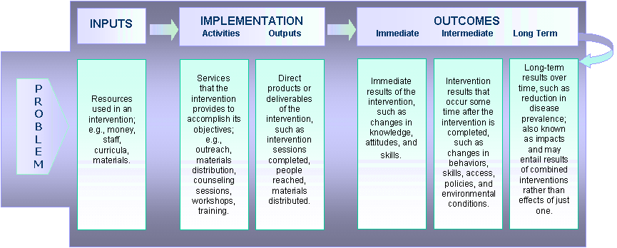
Basic Logic Model

Slide 6
M&E Questions
Monitoring questions
  What is being done?
  By whom?
  Target population?
  When?
  How much?
  How often?
  Additional outputs?
  Resources used? (Staff, funds, materials, etc.)

Slide 7

M&E Questions
Evaluation Questions?
  Is the content of the intervention or the activity being delivered as planned?
  Does the content of the intervention or the activity reflect the requisite standards?
  Has the intervention achieved the expected results?

Slide 8
Planning a Monitoring System
What should be monitored?
  Keep information requirements to a bare minimum
  Collect info that will be most helpful to those who will use it
How?
  Select methods to track indicators/report on progress
    Observations, interviews, routine reporting, sentinel sites
    Piggyback on existing data collection systems
    Both formal/informal and quantitative/qualitative methods
    Decide how information will be recorded systematically and reported clearly
    Consider the time and skills of those who will collect the data
    Pretest new monitoring instruments

Slide 9
Monitoring Planning
Who should be involved when?
  Clearly identifying who will collect information on indicators, when (frequency) and who will receive it
  The monitoring plan should also identify who will be involved in reviewing progress and providing feedback
What resources are needed and available?
  The human and financial cost of gathering, reporting and reviewing data should be identified
  Needed funding and time should be set aside for this work

Slide 10
Example: Plan to monitor progress toward IPOPCORM
objectives and desired outcomes
Objective | Indicator | Means of Collection | Frequency | Responsible Agency/Person
Objective 1: Improve reproductive health outcomes among people living in coastal communities | 1. Contraceptive prevalence among WRA 2. Correct knowledge about emergency contraception (EC) among WRA 3. % of youth who used any method of contraception during first sex | Behavior Monitoring Survey (BMS) FGD BMS | Every 24 mo. Every 24 mo. Every 24 mo. | NGO Supervisor Outreach Workers (OW) NGO Supervisor
Objective 2: Enhance management of marine and coastal resources at the community level | Biophysical Indicators: percent live coral coverage hectares of mangrove coverage Management Indicators No. and size (km²) of Marine Protected Areas (MPA) under improved management No. of MPA management committees (MMC) established and active No. of fish wardens deputized/active in surveillance and enforcement work No. of validated infractions reported | MPA monitoring survey (for both biophysical Municipal Coastal Database (MCD) NGO output report MMC logbook MMC logbook | Annually Annually Quarterly Quarterly Quarterly | Peoples Organization (MPA management unit) LGU partner NGO Outreach Worker NGO Outreach Worker NGO Outreach Worker
Objective 3: Increase public and policymakers’ awareness and support for PHE | Number of policymakers knowledgeable about the inter-relationships between Population and Environment and Food security Total value of resources leveraged from local governments and communities for implementation of PHE activities | Policy makers’ survey Audit of NGO’s financial records and statements | Annual Every 24 mo. | NGO Project Director PATH Foundation Philippines auditor
10

Slide 11
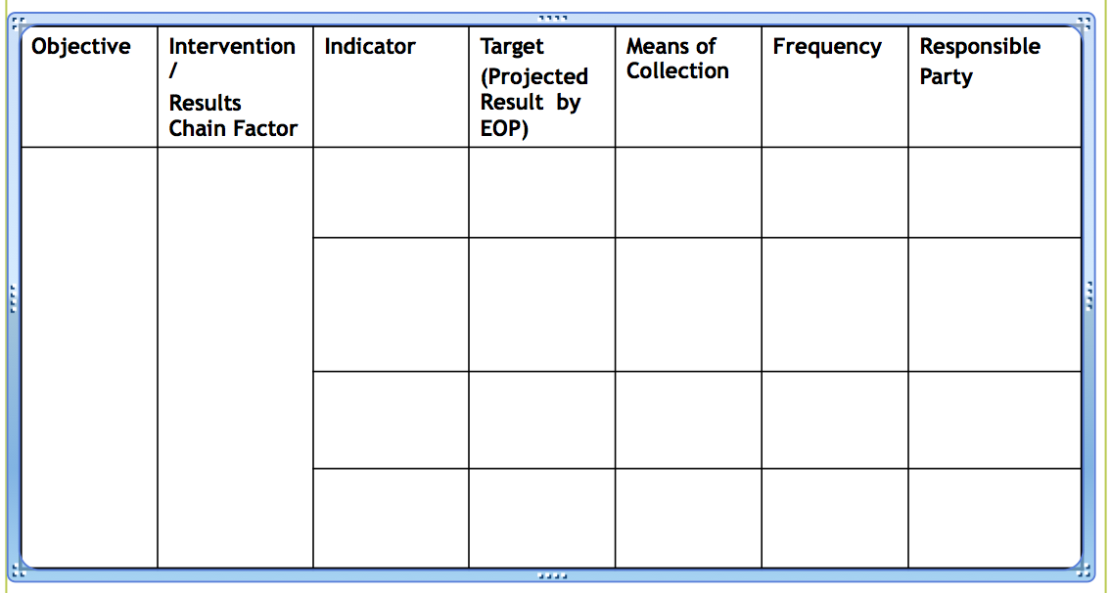
Example Monitoring Tool
https://2010.57.24.png?dl=0
http://www.ehproject.org/eh/projects.html

Slide 12
Exercise: Group work
Use your case study and identify at least:
  Two metrics/indicators for program monitoring and
  Two metrics/indicators for program evaluation
  .
Will this be easy or hard?

Slide 13
Source: CDC. Global AIDS program monitoring and evaluation (M&E) field guide

Slide 14
Examples of Evaluation Metrics
Mizala, Alejandra and Ben Ross Schneider. (2012). “Negotiating Education Reform: Teacher Evaluations and Incentives in Chile (1990–2010),” Governance, an International Journal of Policy, Administration, and Institutions: 27(1)
  Teacher salary and benefits improvement
  Collective incentives for student performance

Slide 15
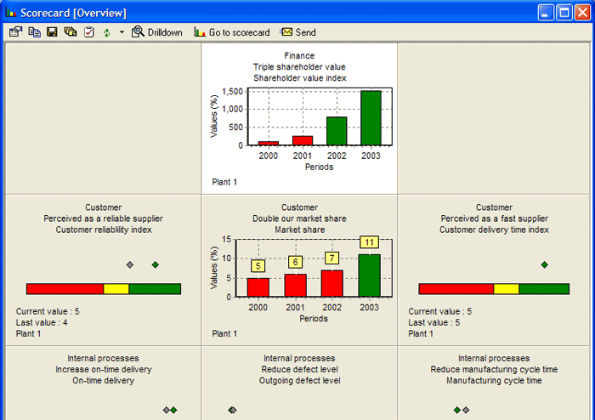

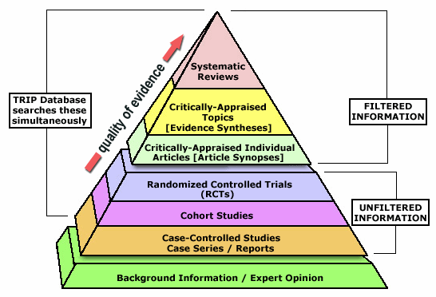
Communication Approaches:
It is a Data-Crunching World!
Big Data
Corporate Dashboards
Lessons from Evidence-Based Medicine
15

Slide 16
How to Develop New Metrics
Depends on what is important to the strategy
  New vision?
  Enterprise problems?
  Community issues?
Where is the leverage?
  Bang for the buck
  Where you have expertise or local knowledge
  Inflection points
Measurement
  Valid
  Reliable
Measures
  Lag
  Lead
  Coincident
What is most difficult?
What are the trade-offs?
16

Slide 17
Examples from the World Bank
17

Slide 18
Focus on Strategic Communication
There are many measures of performance but fewer measures that help with preliminary analyses. Similarly there are not many assessment measures.
Analysis
Intelligence Preparation of the Environment
Identify audience(s)
Understand internal/external audience(s)
Identify information needs and effective tools
Develop assessment methodology
Assessment
Qualitative/quantitative analysis
Are we achieving our objectives?
Are we achieving our effects?
Are measures correct?
Reassess assigned plans/tasks
Recycle back to policy development

Slide 19
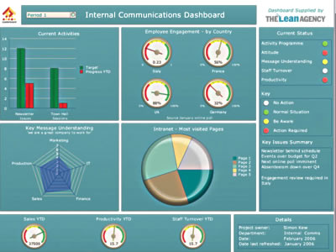

Slide 20

Common Methods
Surveys
Content analysis of documents, interviews, media stories
Communication instruments/tools
Online metrics
Time series analysis
What is most in use now?
What needs the most significant investment?
20
Notes:
I moved up content analysis so I could so surveys and content analysis together

Slide 21
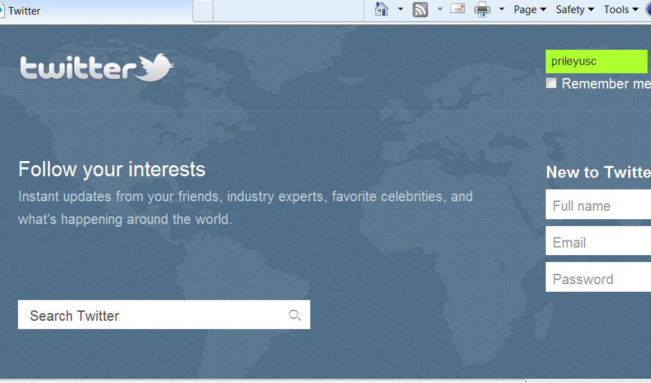
Qualitative Analysis
Focus groups
Narrative analysis
Discourse analysis
Twitter analysis

Slide 22

Surveys
Panel surveys vs. cross-sectional
Random vs. convenience sample
In-person vs. mail vs. internet
Original vs. secondary data

Slide 23
When Surveys are Useful
Understanding your audience
Monitoring & Evaluation
Determining target audience
Determining appropriate intervention methods
Understanding knowledge levels, behaviors, attitudes
Examples:
  Fondation Hirondelle in DRC
  http://www.hirondelle.org/index.php/en/
Baseline and post-intervention surveys on target measures
Examples:
  La Benevolencija in Rwanda
  http://www.labenevolencija.org/rwanda/
  Search for a Common Ground in Angola
  https://www.sfcg.org/programmes/angola/programmes_angola.html

Slide 24
Content Analysis
Content analysis is important in strategic communicationesearchtic description
  Highly selective and structured method
  Utilized on visual, aural or print media or text content
  The rules of analysis are standardized to ensure a high degree of reproducibility
One objective of the content analysis is to examine large amounts of content with statistical methods
Content analysis reduces the complexity of content as it brings out the central patterns of the coverage
Software can make it semi-automated; media tracking
  DiscoverText
  http://www.knime.org/

Slide 25
When Content Analysis is Useful
Understanding your
environment
Monitoring & Evaluation
Understanding media frames and narratives
Assessing media landscapes
Understanding terms of a debate / stakeholder positions
Examples:
  La Benevolencija in Rwanda
  Frelaria?
Baseline and post-intervention analyses
Examples:
  La Benevolencija in Rwanda
  Internews in Bosnia
  Frelaria?

Slide 26
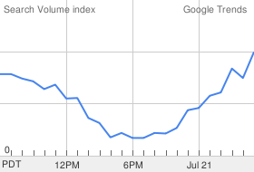
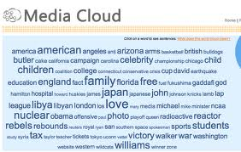
Web Measures
Google trends
Media Cloud

Slide 27
Website Analytics/KPIs
Tracking via Alexa, or similar software for size of audience—SEO working?
Check for impact—e.g., presence of information that migrates to traditional brand media and “aggregators with attitude”
Check entry points—e.g., did they come through the home page or were they linked in from another site to a story or chart?
How many RSS feeds? Bookmarks? Internal links?
Page views per visit ratio is key metric for engagement
  Time spent per page (a less reliable metric)
    High—more than 5 min.
    Med—30 sec. to 5 min.
    Low—less than 30 sec.
How many exit the site after search?
Bounce rate—how long to get to page designated?
Frequency and recency of high use visitor

Slide 28
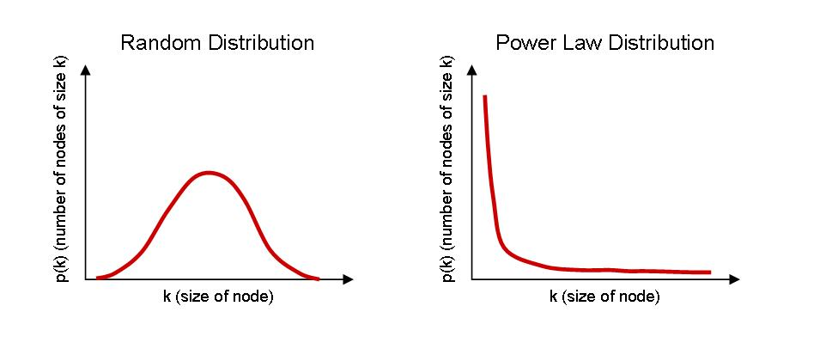
Power Curve
What kinds of things fall into each type of distribution? Bill Gates height vs money?

Slide 29
Social Network Analysis

Slide 30
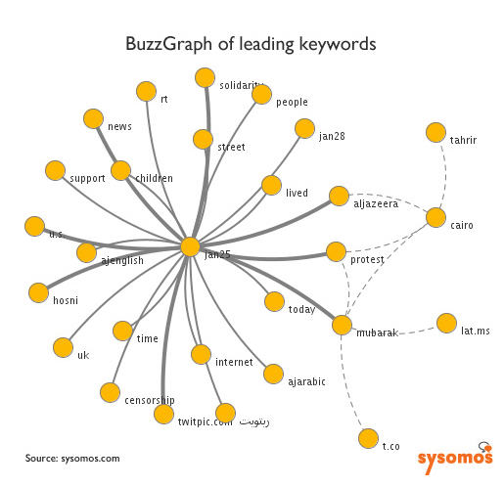
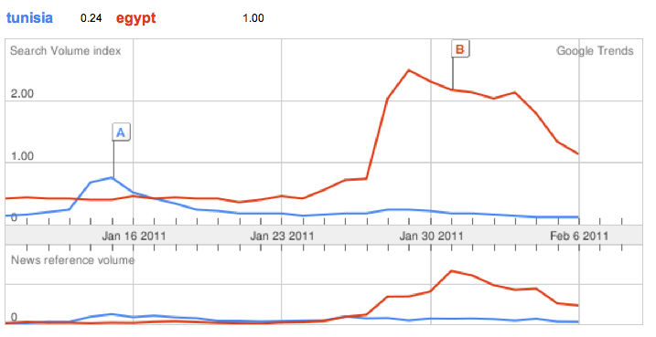
Examples of New Visualization Examples
30
30
30

Slide 31
Time-Series Analysis
Used to analyse movements of a variable over a time period – usually years, quarters, months, etc.
Importance for assessing:
  Seasonality
  Trend
  Key moments
  Magnitude
31

Slide 32
Trend Analysis
Trend removed from data
32

Slide 33
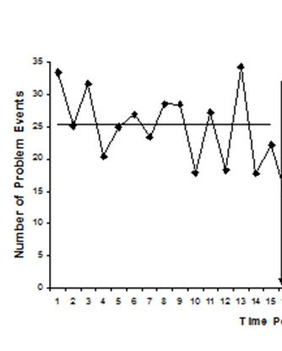
Policing Intervention
33

Slide 34
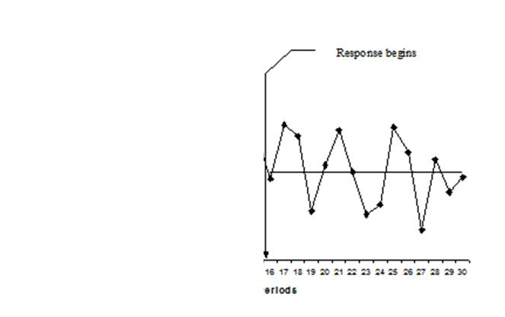
Policing Intervention
34

Slide 35
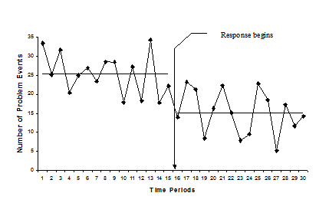
Policing Intervention
They claim success???
35

Slide 36
Possible Data/Metrics/Indicators
Analysis
Assess
What data do you already have?
What data will you need to create?
What data will be the greatest challenge?
What are your final metrics of success?

Slide 37
Homework Task
Draft a basic monitoring and evaluation plan for your project
Make sure that it is tied to your
  Conceptual Model
  Results Chain Factors
  Objectives
  Indicators
  Interventions/Activities
Use the Worksheet entitled “Monitoring Plan Tool” and do a simple goal analysis

Slide 38
Your Goal:
ADOPT A STATISTICIAN!
(or take one to lunch)
38

