Slide 1
Patricia Riley & Gail Thomas Director, Global Communication Program Director, USC Annenberg Scenario Lab (www.uscscenariolab.com)
Building Reform Networks and Embedding Strategic Communication

Slide 2
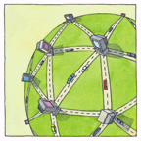
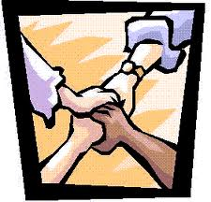
Objectives
To focus on the communication actions required for building coalitions and networks
What does leadership look like in a network?
What would your networks look like?

Slide 3
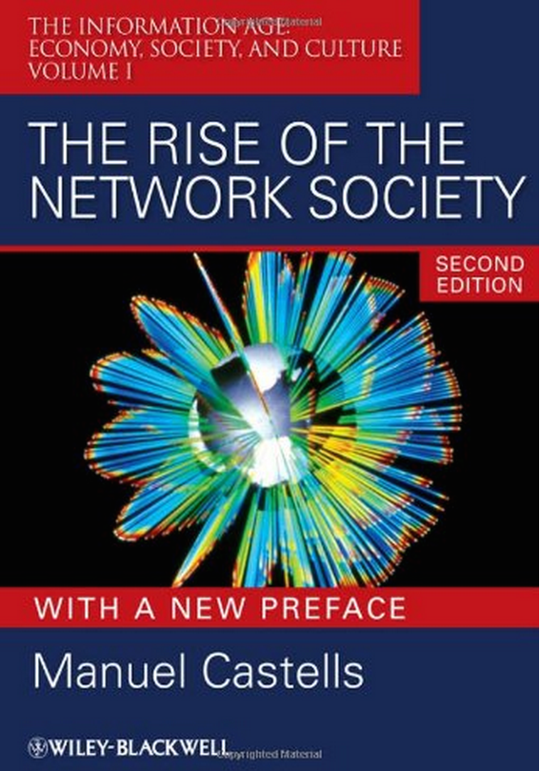
A Network Society
The communication system of the industrial society centered around the mass media
Distribution of a one-way message from one to many
The foundation of the network society is a global web of horizontal communication networks
Multimodal exchange of interactive messages from many to many, both synchronous and asynchronous
Castells, 2007

Slide 4
Governance: From Nests to Webs
Nesting Structure
Network Structure

Slide 5
Moving Beyond Coalitions
Coalitions tend to be bracketed in time
Networks create bridges that enable participants to communicate beyond a campaign or policy
They allow for the pooling of know-how and the exchange of experience.
Span socioeconomic, political, and cultural gaps, networks manage relationships that might otherwise degenerate into counterproductive confrontation (Reinicke and Deng, 2000)

Slide 6
Functions of Global Public Policy Networks
Process
Steering committee
Target stakeholder organizations
Determine goals
Communication plan
Learning Forum
Monthly meetings to start
Annual meetings thereafter
Webinar training schedule for both technical and process material
Flexible sub-committee structure
Agenda-setting
Standard-setting
Generating and disseminating knowledge
Developing innovative implementations
Creating a common culture/shared values

Slide 7
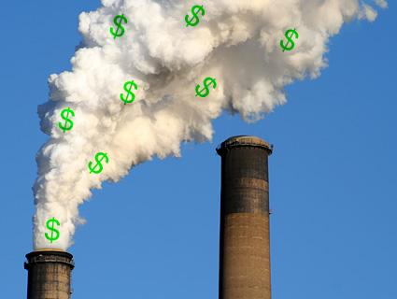
Examples: Three Types
Negotiation Networks
World Commission on Dams (1998)
Initially supported by the WBG, then not supported, morphed to DDP (not a network)
Reviewed by academics as generally successful at negotiating standards
Coordination Networks
Global Water Partnership (1996)
Roll Back Malaria Venture (1998)
Implementation Networks
Clean Development Mechanism (CDM) & Joint Implementation (JI) were both created to implement the Kyoto climate protocol
Participate in pollution reduction and “buy” certified emission reductions

Slide 8
Research on Network Sustainability
Meta-analysis of 16 successful reforms indicates that they shared:
Purposes and direction
A focus on building collaboration, consensus, and commitment
Activities and relationships that formed important building blocks
Leaders have good communication skills – facilitate cross-cultural brokering
Mechanisms for sharing funding problems

Slide 9
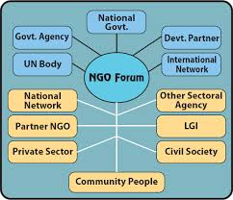
What Does Leadership Look Like in a Network?
Not about position
Based on relationships
Shared decision-making
Requires collaboration skills
Have to know who knows whom
Have to know who knows what
Need to develop knowledge sharing tools
Adapted from Rob Cross

Slide 10
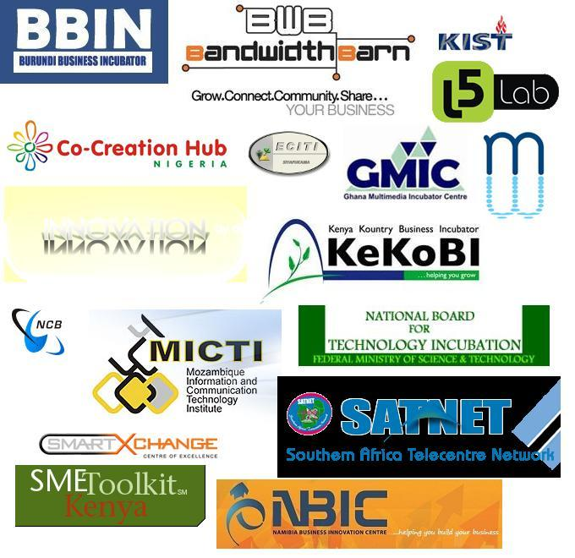
Best Practices for Building Innovative Networks
Assess possible members/partners
Values, innovation, passion and commitment
Jointly create goals
Train members/partners when needed
Develop and track metrics
Collaborators?
Co-Creators?
Partners?

Slide 11
How Can We Build a Supportive Reform Communication Network?
Table Exercise
How could your work improve by building a reform communication network?
What would be the goals?
There is a Linked-In group of prior participants and Facebook groups
What else is needed?
What should happen next?
How could the participants in this room sustain their interactions?
Draw a picture of your network

