Slide 1
Political Navigation
Sina Odugbemi
The World Bank Group
Summer Institute in Reform Communication:
Leadership, Strategy and Stakeholder Alignment
Los Angeles, June 2, 2015

Slide 2
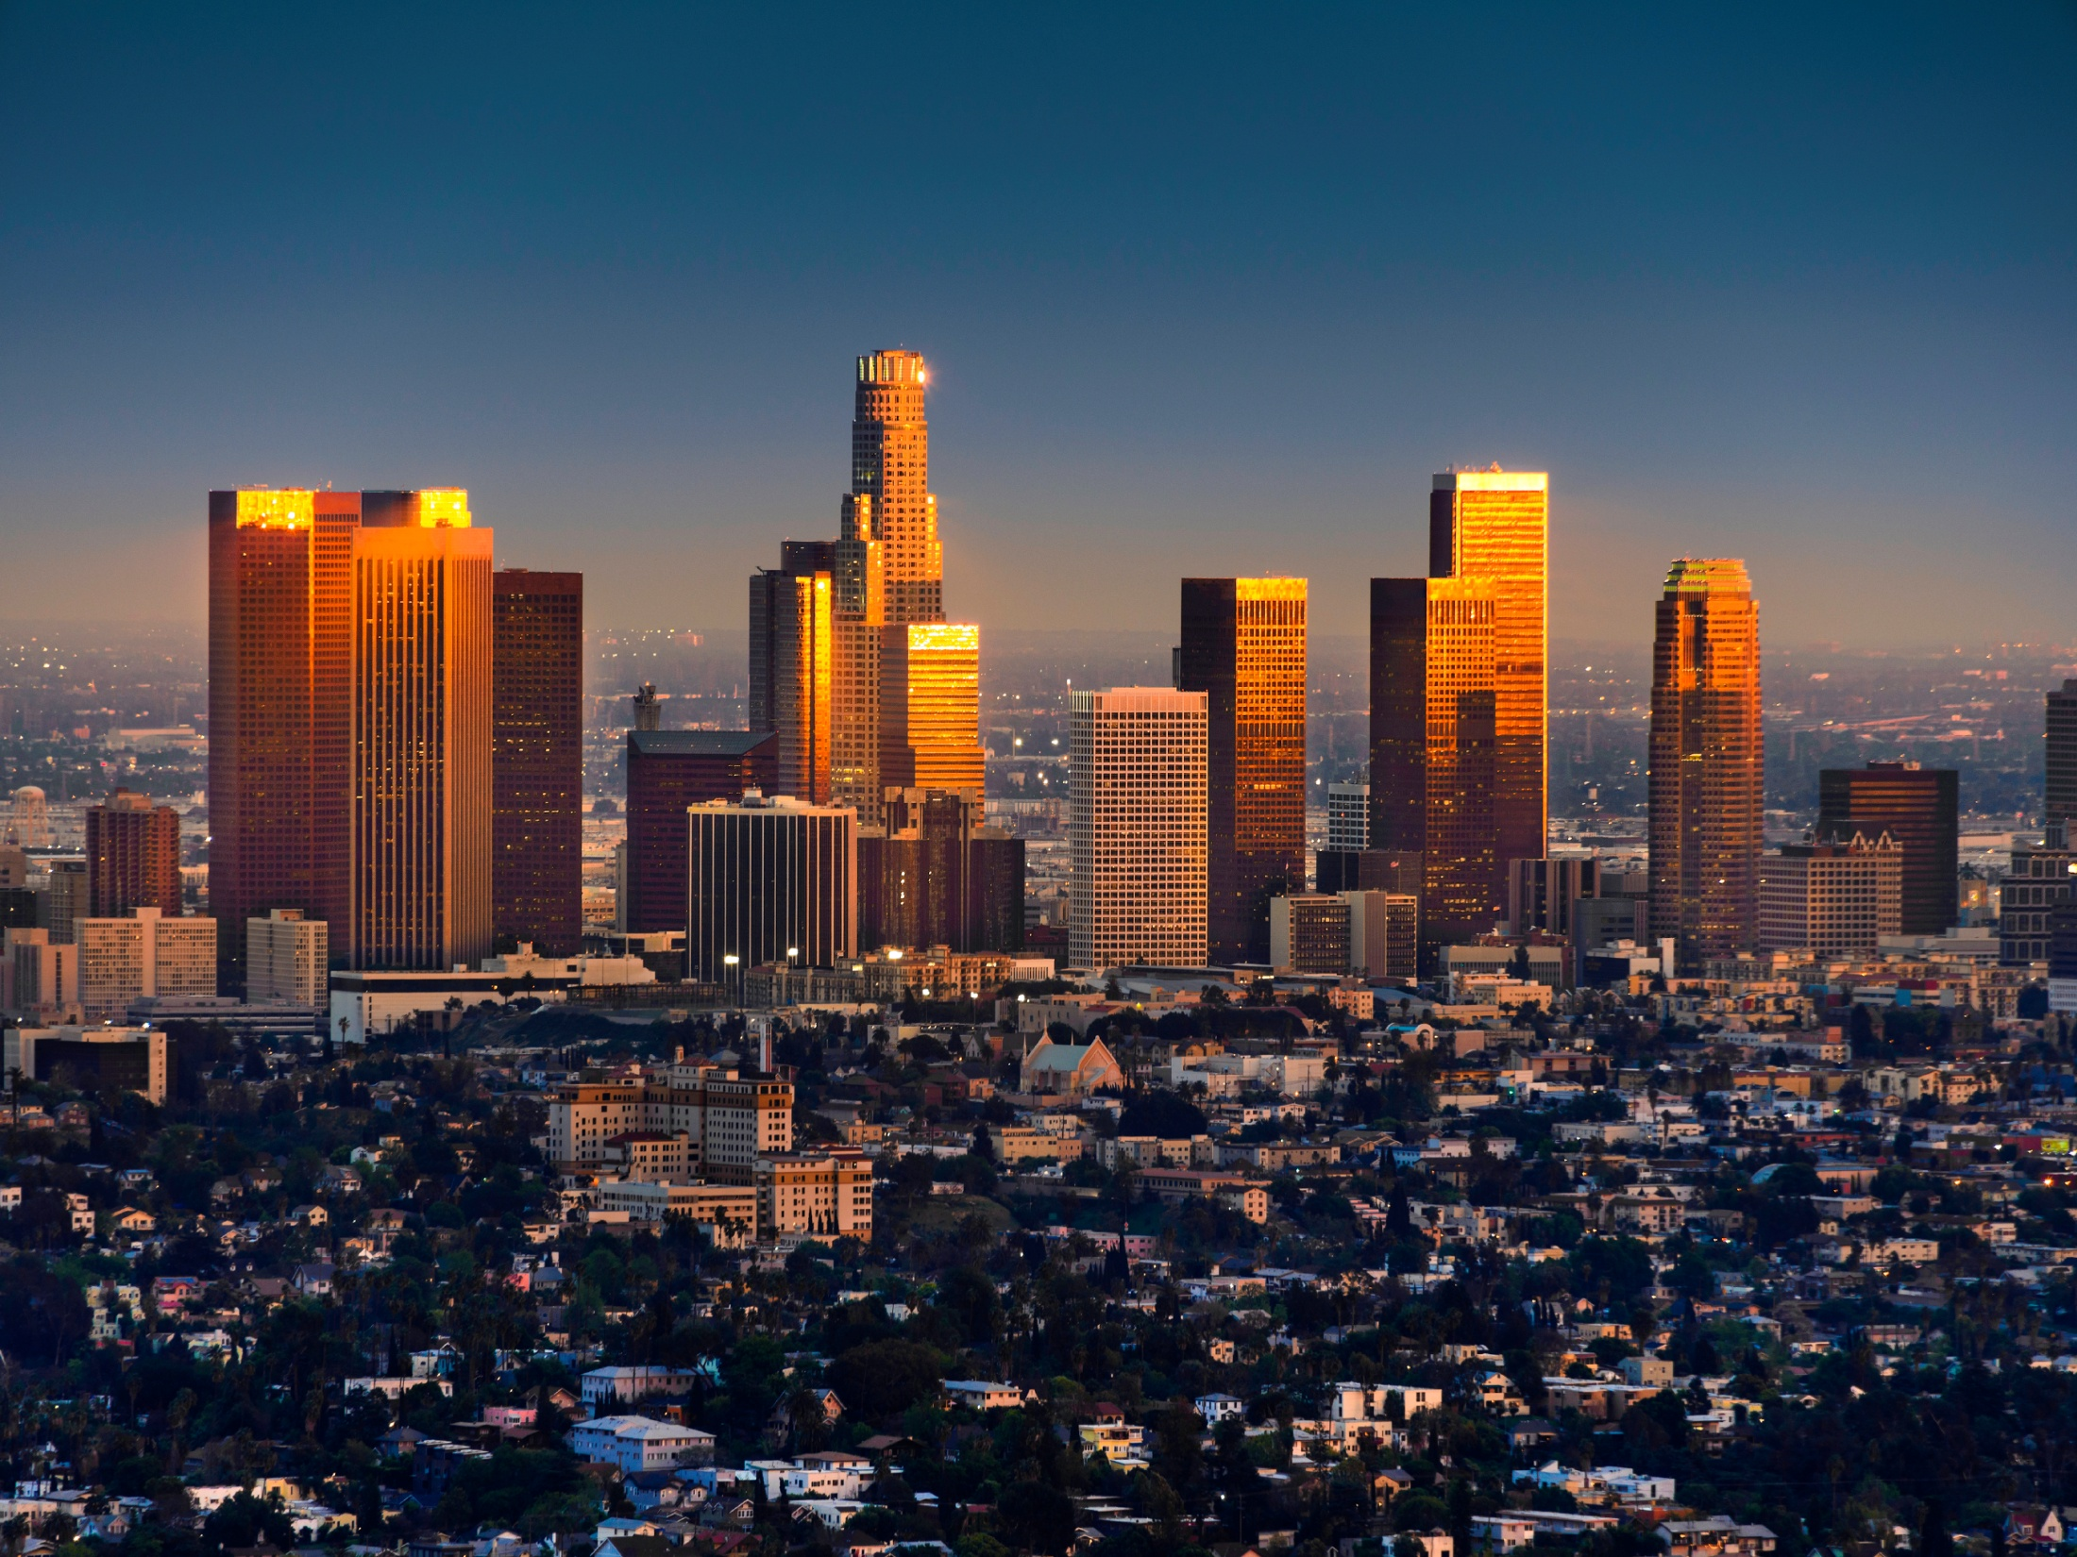
Overview
Deep Probes
How to find a Political Path
The Signal vs. The Noise
The Iceberg
Before the Decision
After the Decision
Group Work

Slide 3
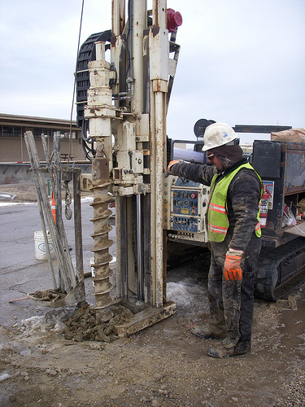
Deep Probes Matter…
……but politics keeps moving

Slide 4
Where are we?
South Korea under Gen. Park Chung-hee; Ethiopia under Meles Zenawi
South Korea, late-1970s to democratic transition
Bangladesh, Zambia
South Africa
Nigeria
Working with the Grain, Brian Levy, 2014
Notes:
Dominant discretionary: strong political leadership (perhaps military, civilian, organized around a political party, or around a charismatic individual) has successfully consolidated its grip on power, but formal institutions remain weak, so rule is personalized
Rule-by-law dominant: where institutions are more impersonal but political control remains monopolized
Personalized competitive: politics is competitive, but the rules of the game governing both the polity and the economy remain weak
Rule-of-law competitive: the political and economic rules have become more impersonal— though some other necessary aspects of democratic sustainability have not yet been achieved

Slide 5
How to find a political path
Approach | Grand Political Economy Analysis | Sector-wide Problem-driven Approach | Political Intelligence
What is the approach? | 30,000 feet view of politics | A review of vested interests, challenges, and potential allies for change | Involves establishing a process by which political intelligence is provided to the implementation team
What can it be used for? | Good for systemic reform | Helpful to understanding the sector and political challenges a reform will face in the near future | Helps you navigate a constantly changing political environment
Who does it? | Party elite, Executive leaders | Sector specialists with political advisors | At least one political insider, or more
How frequently? | Historical, seldom done | Once at the beginning of the reform cycle | Part of day-to-day operations
Lead to Actionable Intelligence

Slide 6
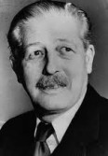
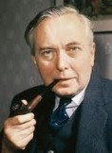
… politics is dynamic
UK Prime Minister (1957-1963) Harold Macmillan when asked what is most likely to blow governments off course:
“Events, my dear boy, events.”
“A week is a long time in politics”
Harold Wilson, UK Prime Minister 1964-1970

Slide 7
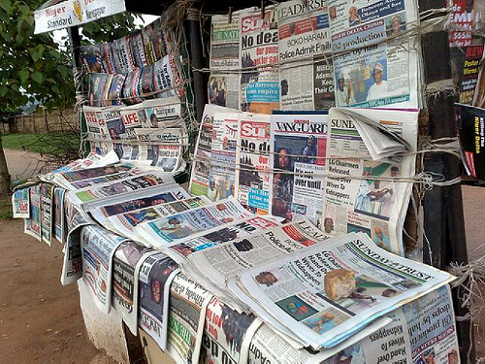
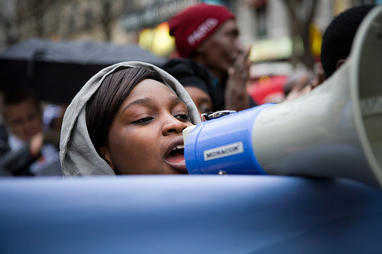
The Signal
vs.
The Noise
Notes:
Most of day-to-day politics is noise
Next: a couple of frameworks for picking what might be significant

Slide 8
The iceberg is everywhere
Regulative (activities, resources)
Formal institutional content: Above the waterline, in view
Waterline
Informal institutional content: Below the waterline, out of view
Normative (activities, resources)
Cultural, cognitive (activities, resources)
From The Limits of Institutional Reform in Development, by Matt Andrews
Notes:
The rules of the game
Values, norms, beliefs and rationalizations that provide both a logic and a propellant for action
Institutional logics
Example: constitutional conventions
Key issue: How are decisions really taken?
Stories:
There are two reasons why you do something: the good, the real
Beyond captain, all appointments are political (below the waterline)
The meeting before the meeting
Committees of the Great and the Good

Slide 9
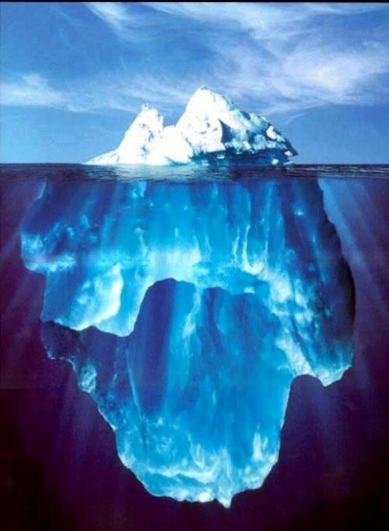
Diving below the waterline
Who really rules?
How do they maintain political support?
How are decisions really made?
Notes:
Now, three examples to make these points

Slide 10
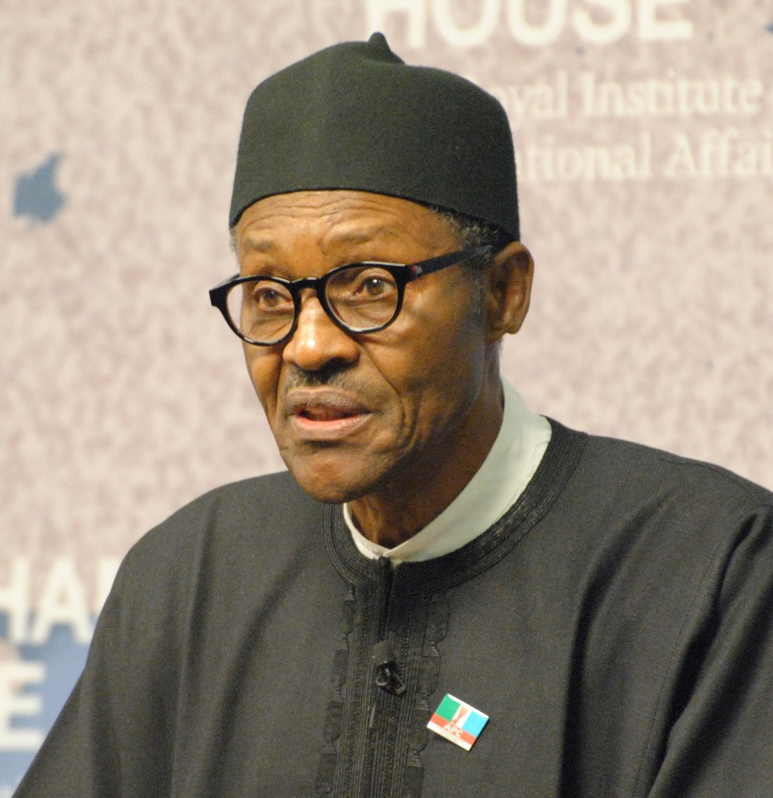
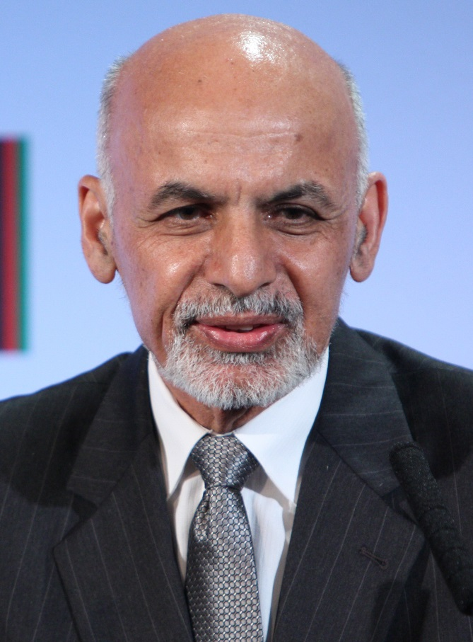
Discover the elite settlement
President Muhammadu Buhari of Nigeria
President Mohammad Ashraf Ghani of Afghanistan
Notes:
Nigeria
Nigeria is ruled by a few hundred “Big Men”
They lead patron-client networks
They do their horse-trading at night, often till morning. It is governed at night
Exceedingly corrupt
Rules:
-No president for life
-Don’t kill heads of networks
-Don’t go after money made in office
Zoning and alternation of power between North and South
System currently in crisis
Afghanistan
A system of major power brokers: political leaders or former mujahideen leaders
An elaborate system for trading favors
Powerful role of ancient tribal norms and practices
“This is how we do things around here.”

Slide 11
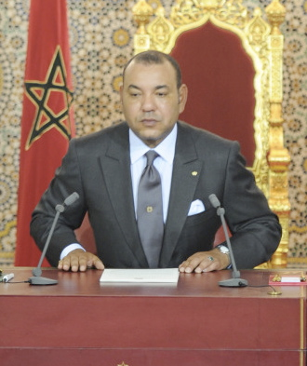
A disciple of Edmund Burke? Reform in order to conserve
King Mohammed VI of Morocco
“M6”
Notes:
King Mohammed VI has ruled since July 30, 1999.
Protests in February 2011: Referendum July 2011
Post Arab Spring Reforms: New Constitution
Stronger authority for Prime Minister and Parliament
PM can now appoint government officials
PM comes from party with the most votes in an election
In reality, the power of the monarch is unchanged
Absolute control over military and religious matters
Powerful system of kings advisors in government departments
PM can exercise his powers but subject to King’s approval
No real separation of powers
The king’s letters
Ritual humiliation of ministers

Slide 12
How would you secure a flow of political intelligence in your country?
Exercise

Slide 13
Before the Decision
Problems
Policy
Window
Policies
Politics
Notes:
Multiple Streams Framework (Kingdom, 1995)
Problems: that governments and citizens want to sort out.
Discovered through:
- Indicators
- focusing events, crises
- feedback
2) Policies: Soup of policy ideas floating around
Politics:
- National mood
- pressure group campaigns
- elections have consequences
- administrative turnover
Windows, Coupling, Policy Entrepreneurs
- Windows open and close

Slide 14
The Public Agenda
The Decision Agenda
Formal Decision-making Bodies
Problems
Policies
Politics
The Inside Game
The Decision
Mandate and Money
Underlying rules of the game: below the water line
Notes:
Sausage making can be ugly and messy
My DFID: Hilary B3en and ‘the great and the good’

Slide 15
Reforms at Risk
All of this work is not just about a reform that can be implemented, but a reform that can be sustained
Reforms are reversible… unless stakeholder support continues
Stage One: There is a decision point- a reform is decided upon, reform and policy options are picked, and resources are allocated.
Stage Two: Opponents do not necessarily give up— unless reform is self-sustaining (for example, telecommunications deregulation)

Slide 16
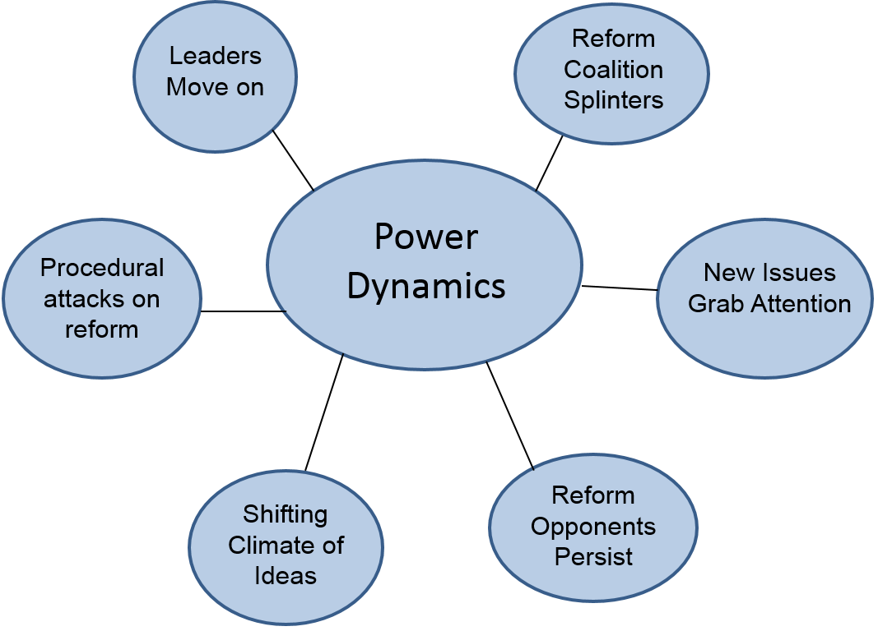
After the Decision

Slide 17
Meaning Well vs.
Knowing How
…astute tactical maneuvering.

