Slide 1
Stakeholder Analysis for Communication
Patricia Riley, Ph.D.
Rebecca Weintraub, Ph.D.

Slide 2
The Need to Put Communication at the Center (C@C)
The Problem
The world is changing rapidly and becoming hyper-connected, but most groups, organizations or governments are not designed for excellent communication and most leaders and members are not excellent communicators. Riley & Eisenberg, 2011

Slide 3
Reform Requires Change
Political Will
Social Will
Organiza-tional Will
Comm. at the Center
C@C Philosophy
Change requires a multifaceted approach that looks at communication issues across the environment
Need to leverage communication in all areas for best results

Slide 4
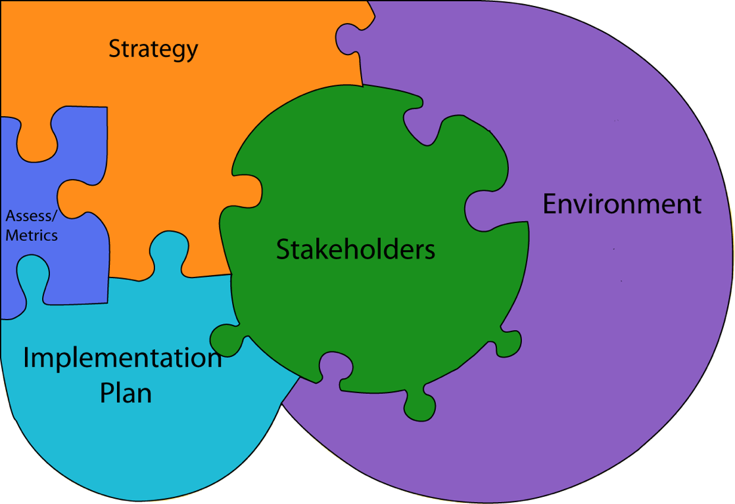
Communicating Strategically

Slide 5
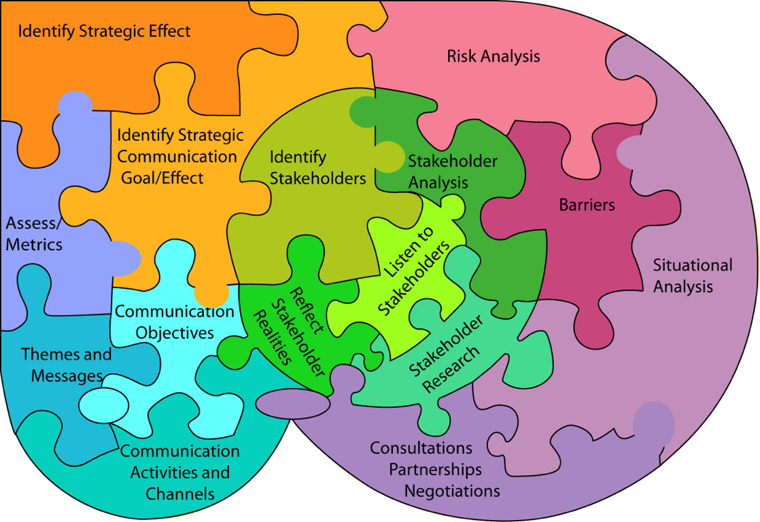
SC Process Elements
9

Slide 6
Impact and Attitude/Support
Impact
Adversaries
Advocates
Attitude/ Support
Antis
Allies

Slide 7
Know Thy Stakeholders
X
High
Impact
X
X
X
X
X
Negative
Attitude
X
Positive
Attitude
X
X
X
Low
Impact
X

Slide 8
Questions to Ask
Are we maximizing desired effects with a communication strategy?
Have we identified and analyzed our key stakeholders?
What are the historical relationships?
Do we have the data we need?
How will we communicate/engage with internal and external stakeholders to achieve our desired effects?
What messages do our actions convey?
How might various stakeholders interpret our actions?
What are the effects or unintended effects?

Slide 9
Strategic Communication Thought Process
Strategic Goal / Objective
Strategic Communication Goal / Objective
Risks If the Goals and Objectives are Not Met
Situational Analysis
Stakeholder Identification

Slide 10
Strategic Communication Analytical Process
Communication Objective(s) by Stakeholder Group
Themes
Metrics
Stakeholder Perceptions (validated by research)
Implications of Perceptions in Support or Against
Messages and Channels by Stakeholder Group

Slide 11
Link Stakeholder Outcomes to Communication Activities
Stakeholders | Desired Outcome (think, do, say) | Measure of Effectiveness | Comm. Activity | Comm. Measure
External:
Internal:
Intra-org:

