Slide 1
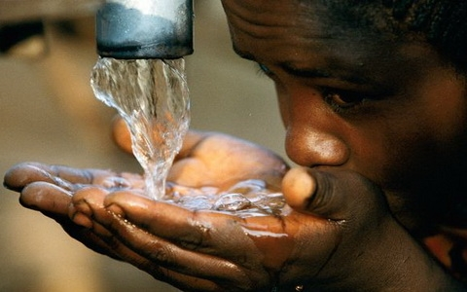
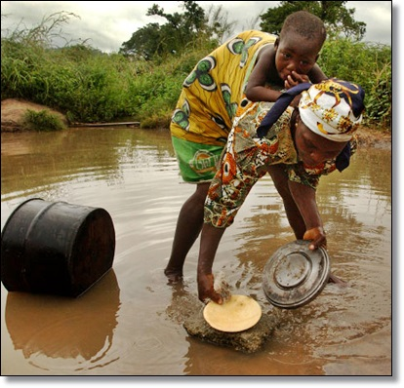
Constraints to Collective Action
Ceren Ozer
June 1, 2015
World Bank-Annenberg Summer Institute
In Reform Communication
University of Southern California, Los Angeles, CA
Collaborating to achieve collective results

Slide 2
Why talk about collective action?
How?
Coalition Building
Leadership
(mobilizing people, ideas, resources for
collective action to create public value)

Slide 3
Constraints to Collective Action:
The Case of Montesinos in Peru
Judiciary
Civil Society
International
Legislative Branch
Alberto Fujimori
State (Bureaucracy)
Political Parties
1
Vladimiro Montesinos
Military
Media
Private Sector
Municipal Government
Source: “Robust Web of Corruption: Peru’s Intelligence Chief Vladimiro Montesinos,” Kennedy School of Government Case Program, Case C14-04-1722.0, based on research by Professor Luis Moreno Ocampo; Peru: Resource Dependency Network, 2000

Slide 4
What is collective action?
The situation in which multiple individuals would benefit from a certain action BUT associated cost makes it implausible that any one individual can or will undertake and solve the problem alone.
We will see that wildly dissimilar problems share incentive structures that are remarkably alike. With
an improved understanding of the real nature of the problem, and
an ability to name things,
We are able to better develop strategies as a collective and translate our collective intentions into action.

Slide 5
Adventures of Eli the Elevator

Slide 6
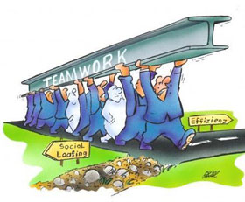
Free rider
I use … You pay…
…but the community loses

Slide 7
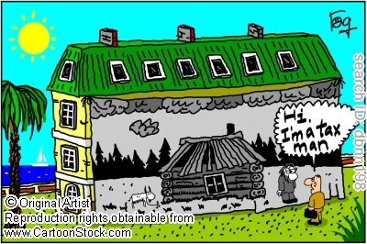
Asymmetric Information
I know…He doesn’t...
I gain!
…but the community loses
My house is only worth $2,000
Notes:
.

Slide 8
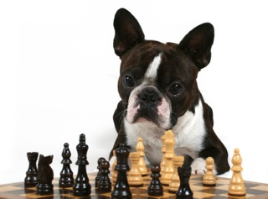
Agenda Setting
Strategic use of decision rules and procedures

Slide 9
Credible Commitment
I break my promise…
I suffer

Slide 10
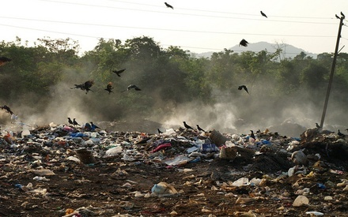
Tragedy of the Commons

Slide 11
Constraints to change and a few selected interventions
Selected Constraints to Collective Action: What different stakeholders might confront and what they can do to address them ?
The Free Rider
Asymmetric Information
Agenda Setting
Lack of Trust
Tragedy of the Commons
Sanctions
Bundling
Lobbying
Awareness Campaign
Knowing Rules
Preferences
Repeated Meetings
Credible Commitment
Trust, reciprocity, reputation, cooperation
Constraints to Change

Slide 12
Constraints to Collective Action Exercise
Personal reflection and journaling: please take 5 minutes and reflect on the concepts we reviewed.
Identify 1 or 2 illustrations and name the collective action constraint (and/or solution) from your professional or personal experience. Take another 5 minutes and take notes on your worksheet.
At your tables in trios dialogue your experiences of these concepts for 15 minutes.
Plenary dialogue.

Slide 13
Summary Slide: What is Collective Action?
Change is often stymied because relevant parties face certain constraints to collective action that limit their ability to connect and collaborate with one another. Collective action refers to any situation in which multiple individuals would benefit from a certain action except for an associated cost making it implausible that any one individual can or will undertake and solve the problem alone. It is a term that has roots in many areas of the social sciences including psychology, sociology, political science and economics. Collective action issues are at the very heart of development. When properly understood and used effectively, collective action has the power to reach better development outcomes. Common issues in collective action include:
Free rider – a situation in which individuals or organizations consume more than their fair share of a resource or shoulder less than a fair share of the costs of its production
Information Asymmetry – one party has more or better information than the other, leading to an imbalance of power
Credible Commitment – any arrangement or mechanism that makes it very costly for someone to go back on a promise
Tragedy of the Commons – when an actor exploits common resources, like water, but in so doing contributes to the depletion of such a good
Agenda Setting – the strategic use of rules and procedures by an individual or group to influence a decision toward an outcome that is more favorable to them

Slide 14
Plenary dialogue— Can someone tell me what’s going on?

